Slide 2
Seminole
Hayden, Sinclair, Marcilee, Tyler, Haley

Slide 3
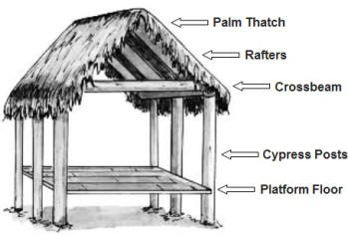
Real Estate Agent By:Tyler Austin
The Seminoles lived in houses called chickees.
Seminole chickees were made out of wood and plaster.
The roofs were made of thatched palmetto leaf fiber.
They lived in these houses to keep away swamp animals and protect from floods.

Slide 4
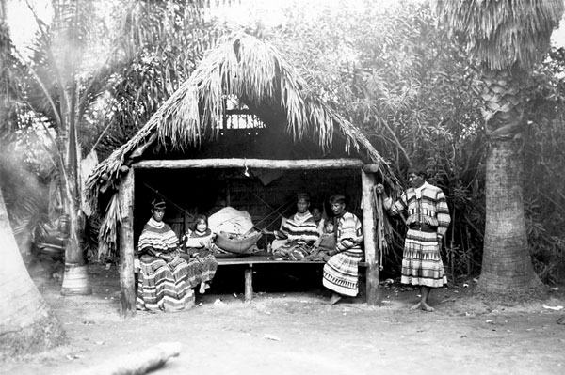
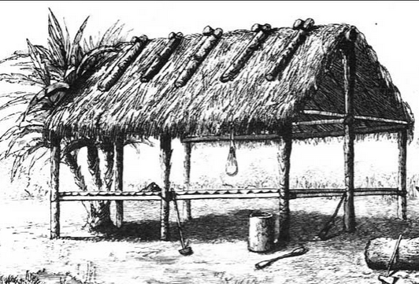
Some images of homes of seminoles:tyler austin

Slide 5
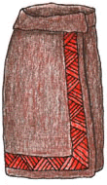
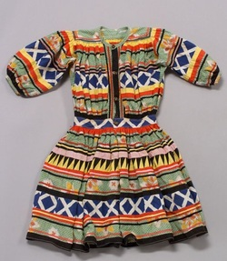
Clothing :HAYDEN
Men: breechcloths
Women: wraparound skirts, usually woven from palmetto.
Shirts were not necessary in Seminole culture, but men and women both wore poncho-style shirts called mantas in cool weather.
The Seminoles also wore moccasins made from animal hides on their feet.
Materials: They used cotton, palmetto fibers, and hides to make their clothes but didn’t use much hide because the weather was warm. They used more plant materials to keep themselves cool.

Slide 6
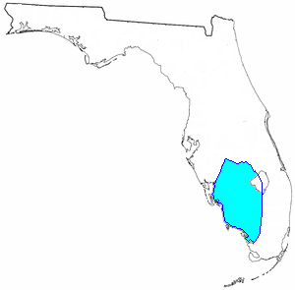
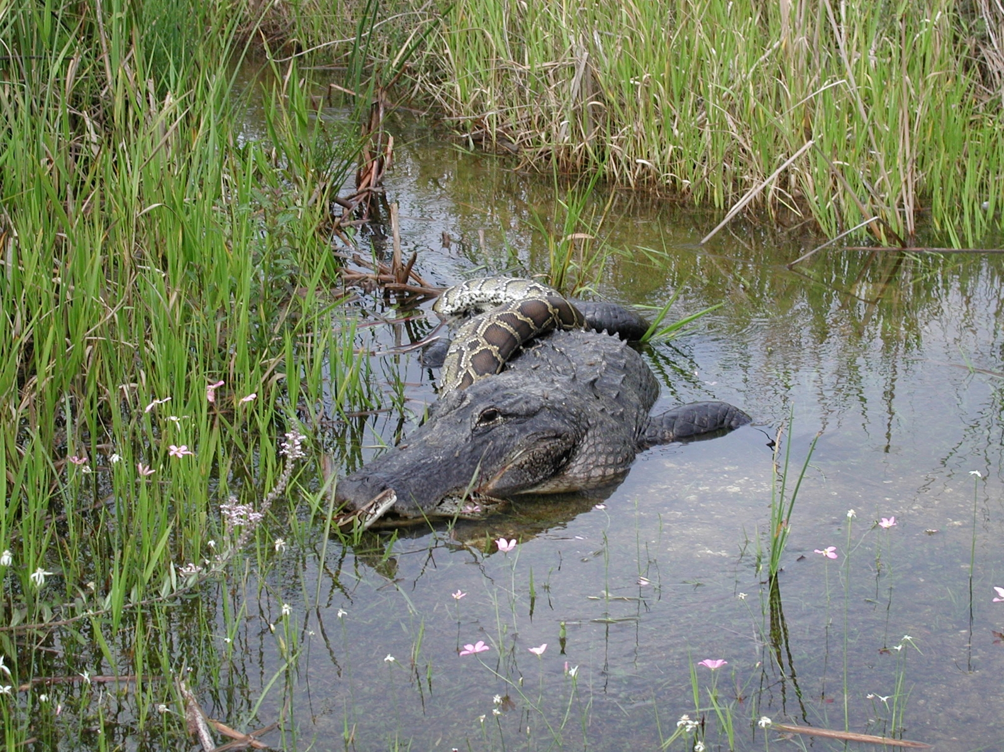
GEOGRAPHY SINCLAIR RICHMAN
GEO
THe seminoles settled in Florida after forming from Native Americans of the Creek tribe.
There were no tribes near them
there were rivers, lakes, swamps, and the ocean.
They faced warm and muggy temperatures.

Slide 7
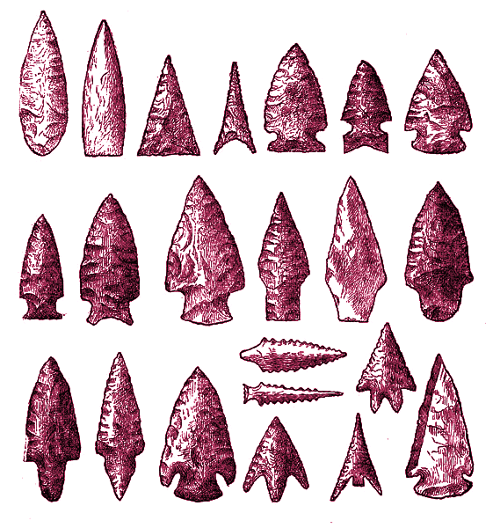
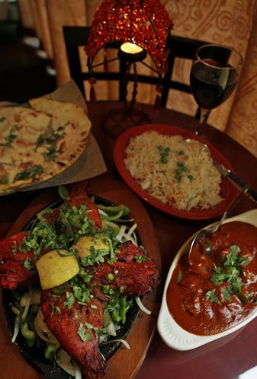
Seminole Food by:Marcilee Kinerman
Men used bows and arrows to hunt and spears to catch fish.
The women grew corn, beans, squash, and Indian potatoes.
They sweetened their food with cane sugar.
They ate this food because it was easy to grow and available to the Seminoles .

Slide 8
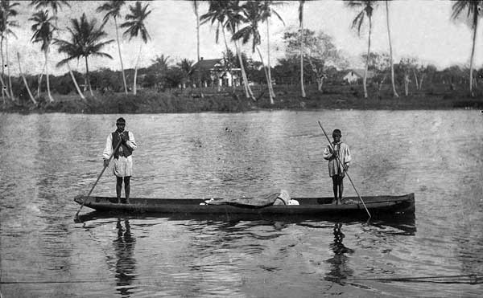
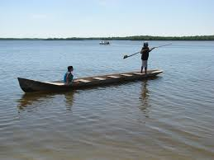
Community Resources By: Haley K.
Men:hunters and sometimes went to war to protect their families
Women:farmers and also did most of the child care and cooking
BOth: Both genders took part in storytelling, artwork and music, and traditional medicine.
Children: played with each other, helped around the house, and learned skills from their parents
Transportation: flat dugout canoes from hollowed-out cypress logs. They steered these boats with poles rather than paddles, and sometimes used sails made from palmetto fiber.

Slide 9
Thanks for watching the
Seminole
Tribe

