Slide 1
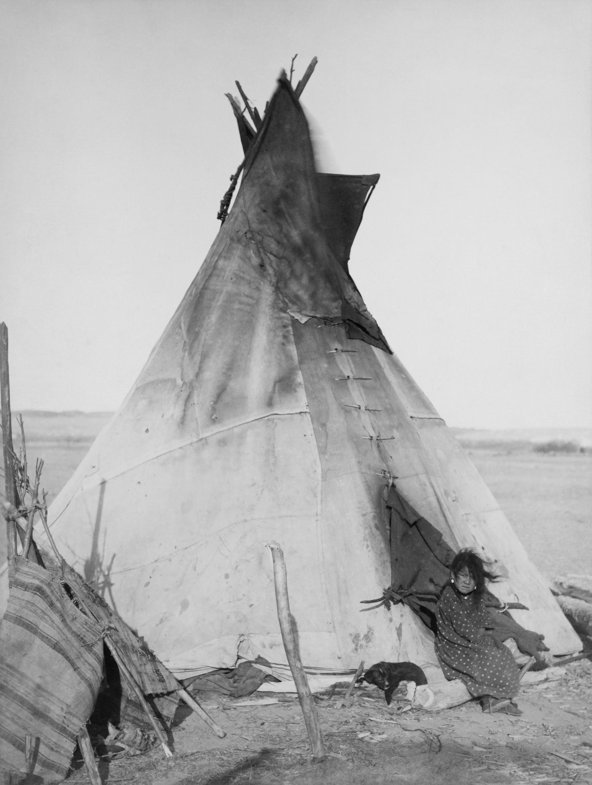
Pawnee
Say:paH-nee
Oliver, Hilary, Lila, Miguel, Dylan
eNJOY THE SHOW!

Slide 2
Clothes worn by the Pawnee Tribe By: Dylan
The clothes were mainly made out of buffalo fur and hide, but also deerskin.
The women would usually make the clothing, decorating it with porcupine quills and beads.
Men:
breechcloths and leather leggings
Warriors: buckskin shirts.
cloaks and blankets to keep warm and dry in cold weather.
They also wore a soft turban of fur
Women:
poncho-like blouses and deerskin skirts
buffalo robes to keep warm and dry

Slide 3
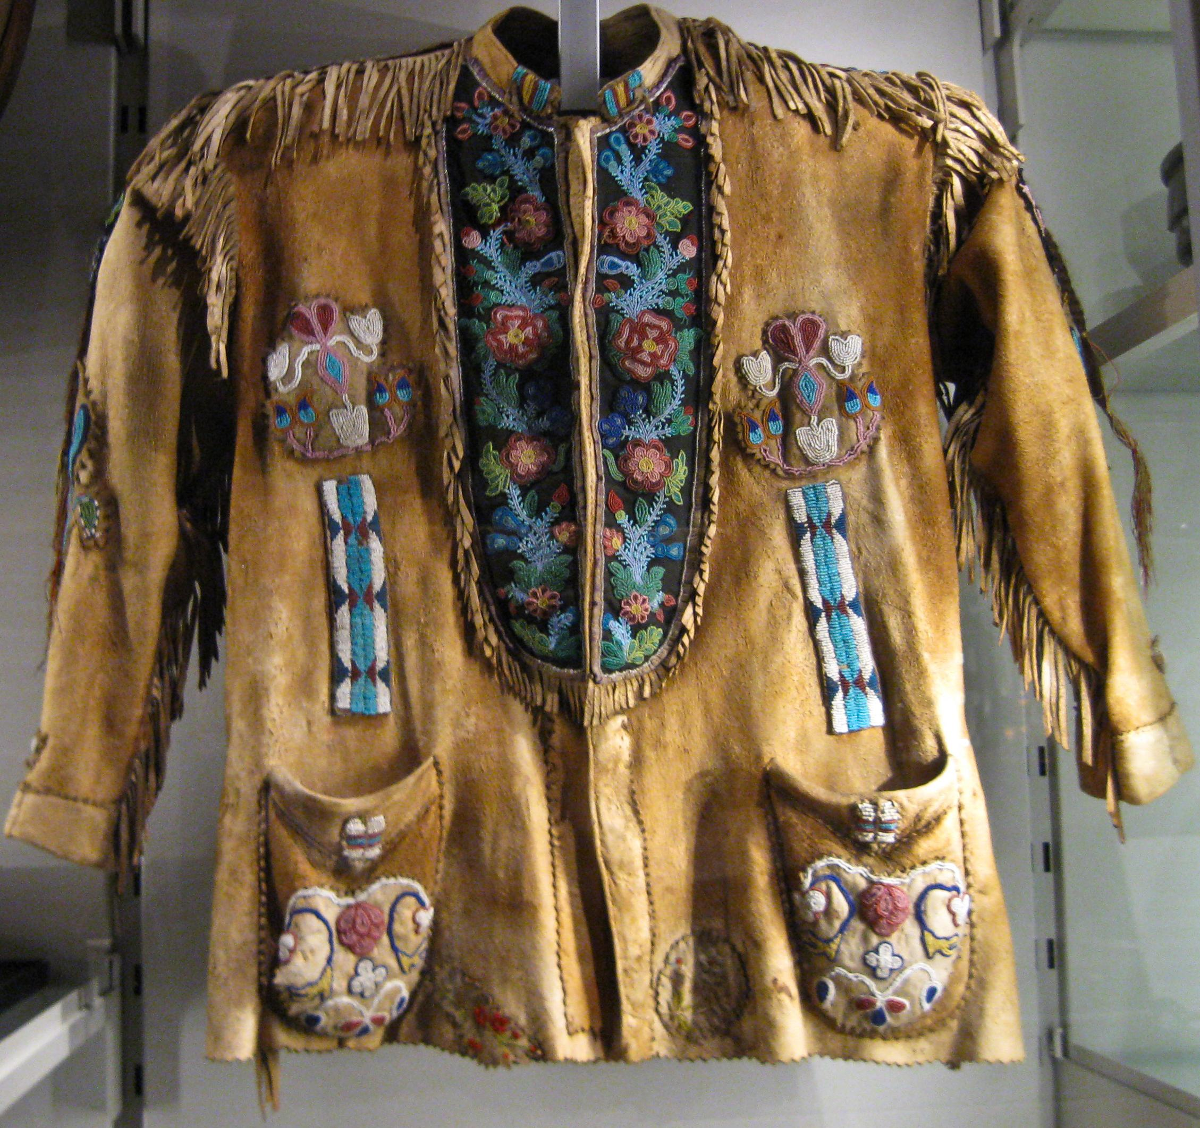
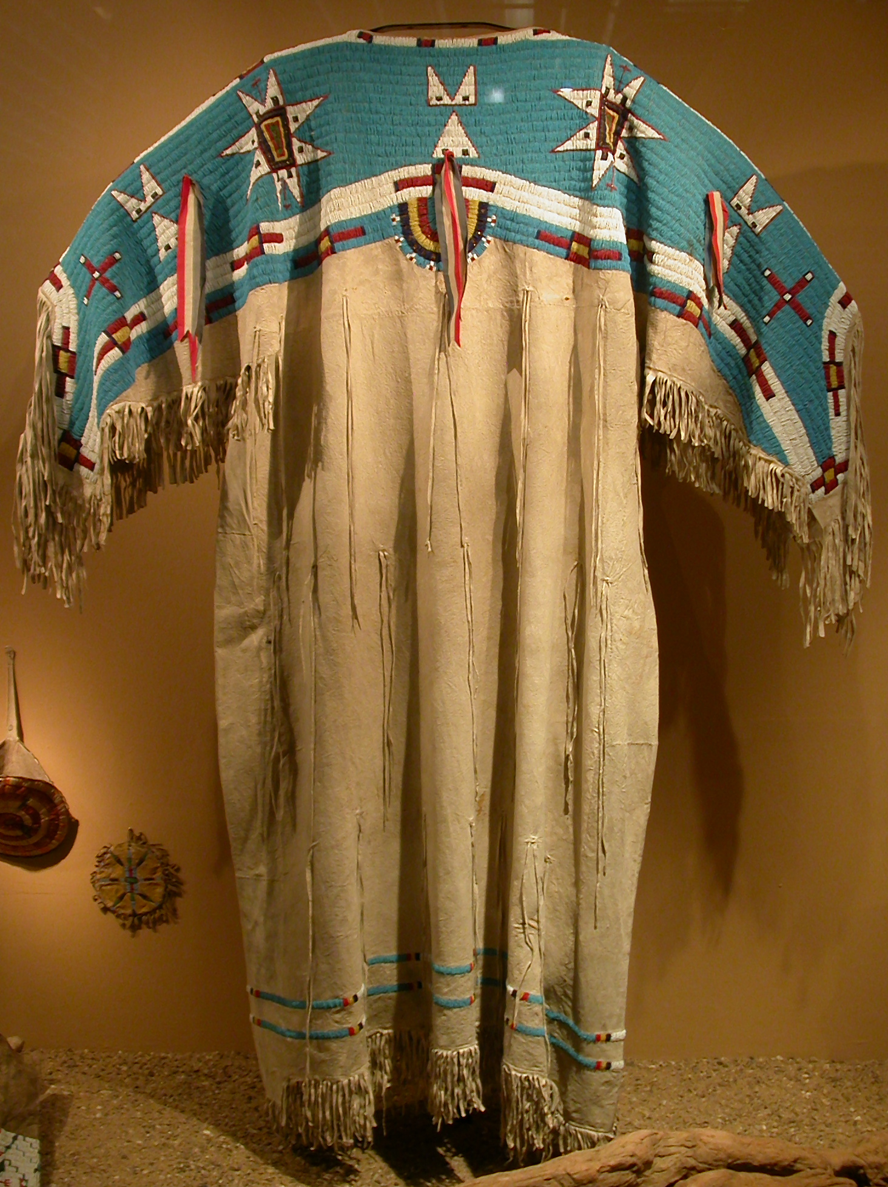
Clothing for men and women
poncho-like blouse made from buffalo hide and other materials
Warrior buckskin shirt

Slide 4
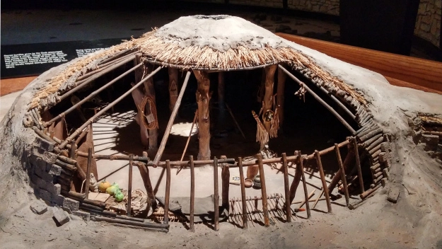
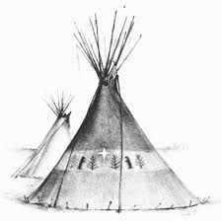
Pawnee Tribe Houses By: Miguel
Earthen houses:
permanent, because they could hold against strong weather.
built by placing long sticks to make the shape and layering the poles with reeds and earth.
Teepees:
temporary shelter, used for hunting trips
more simple because the would place long sticks in a cone shape and wrap it in buffalo hide

Slide 5
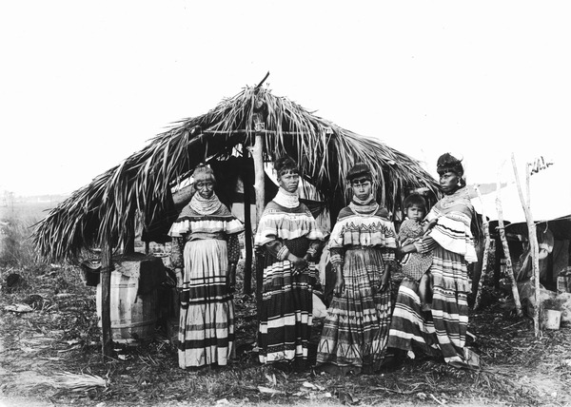
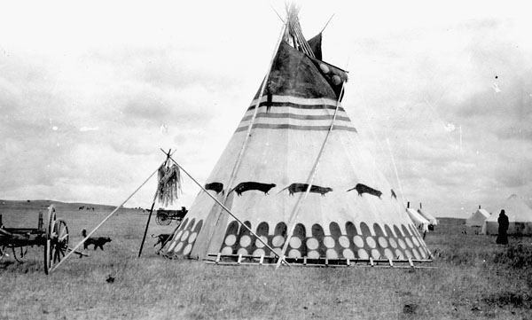
Houses
This is an earthen house(earthen lodge). Its main purpose is to provide permanent shelter.
This is a Teepee. It was made for temporary shelter, although it was moved a lot, because of hunting trips.

Slide 6
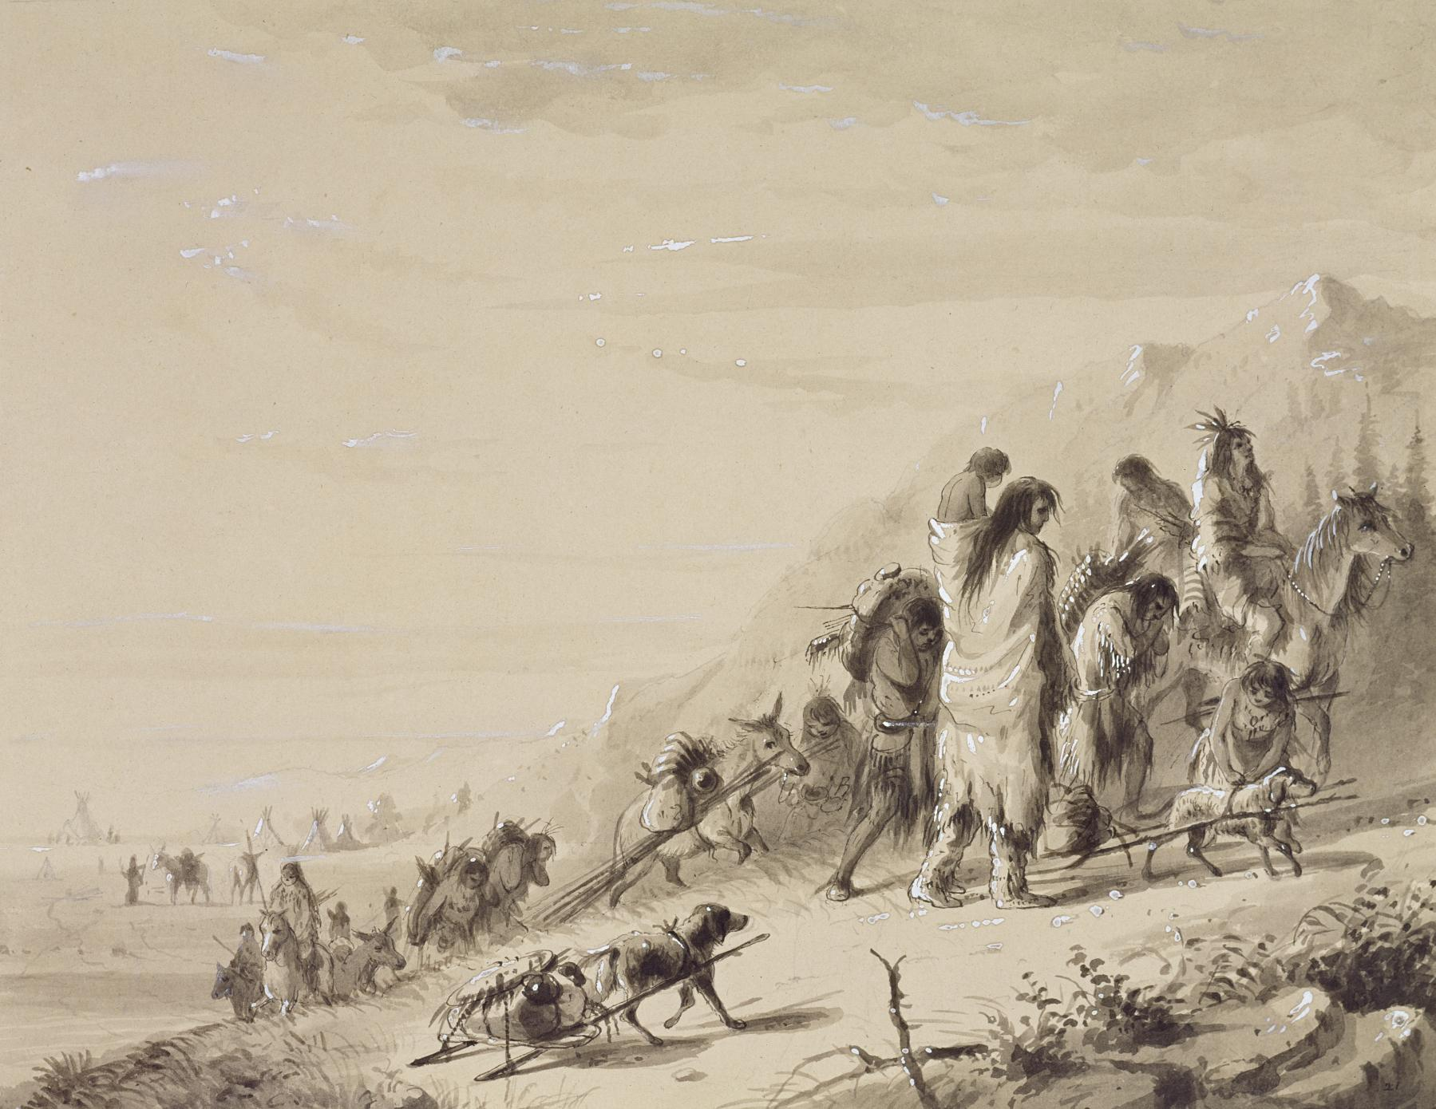
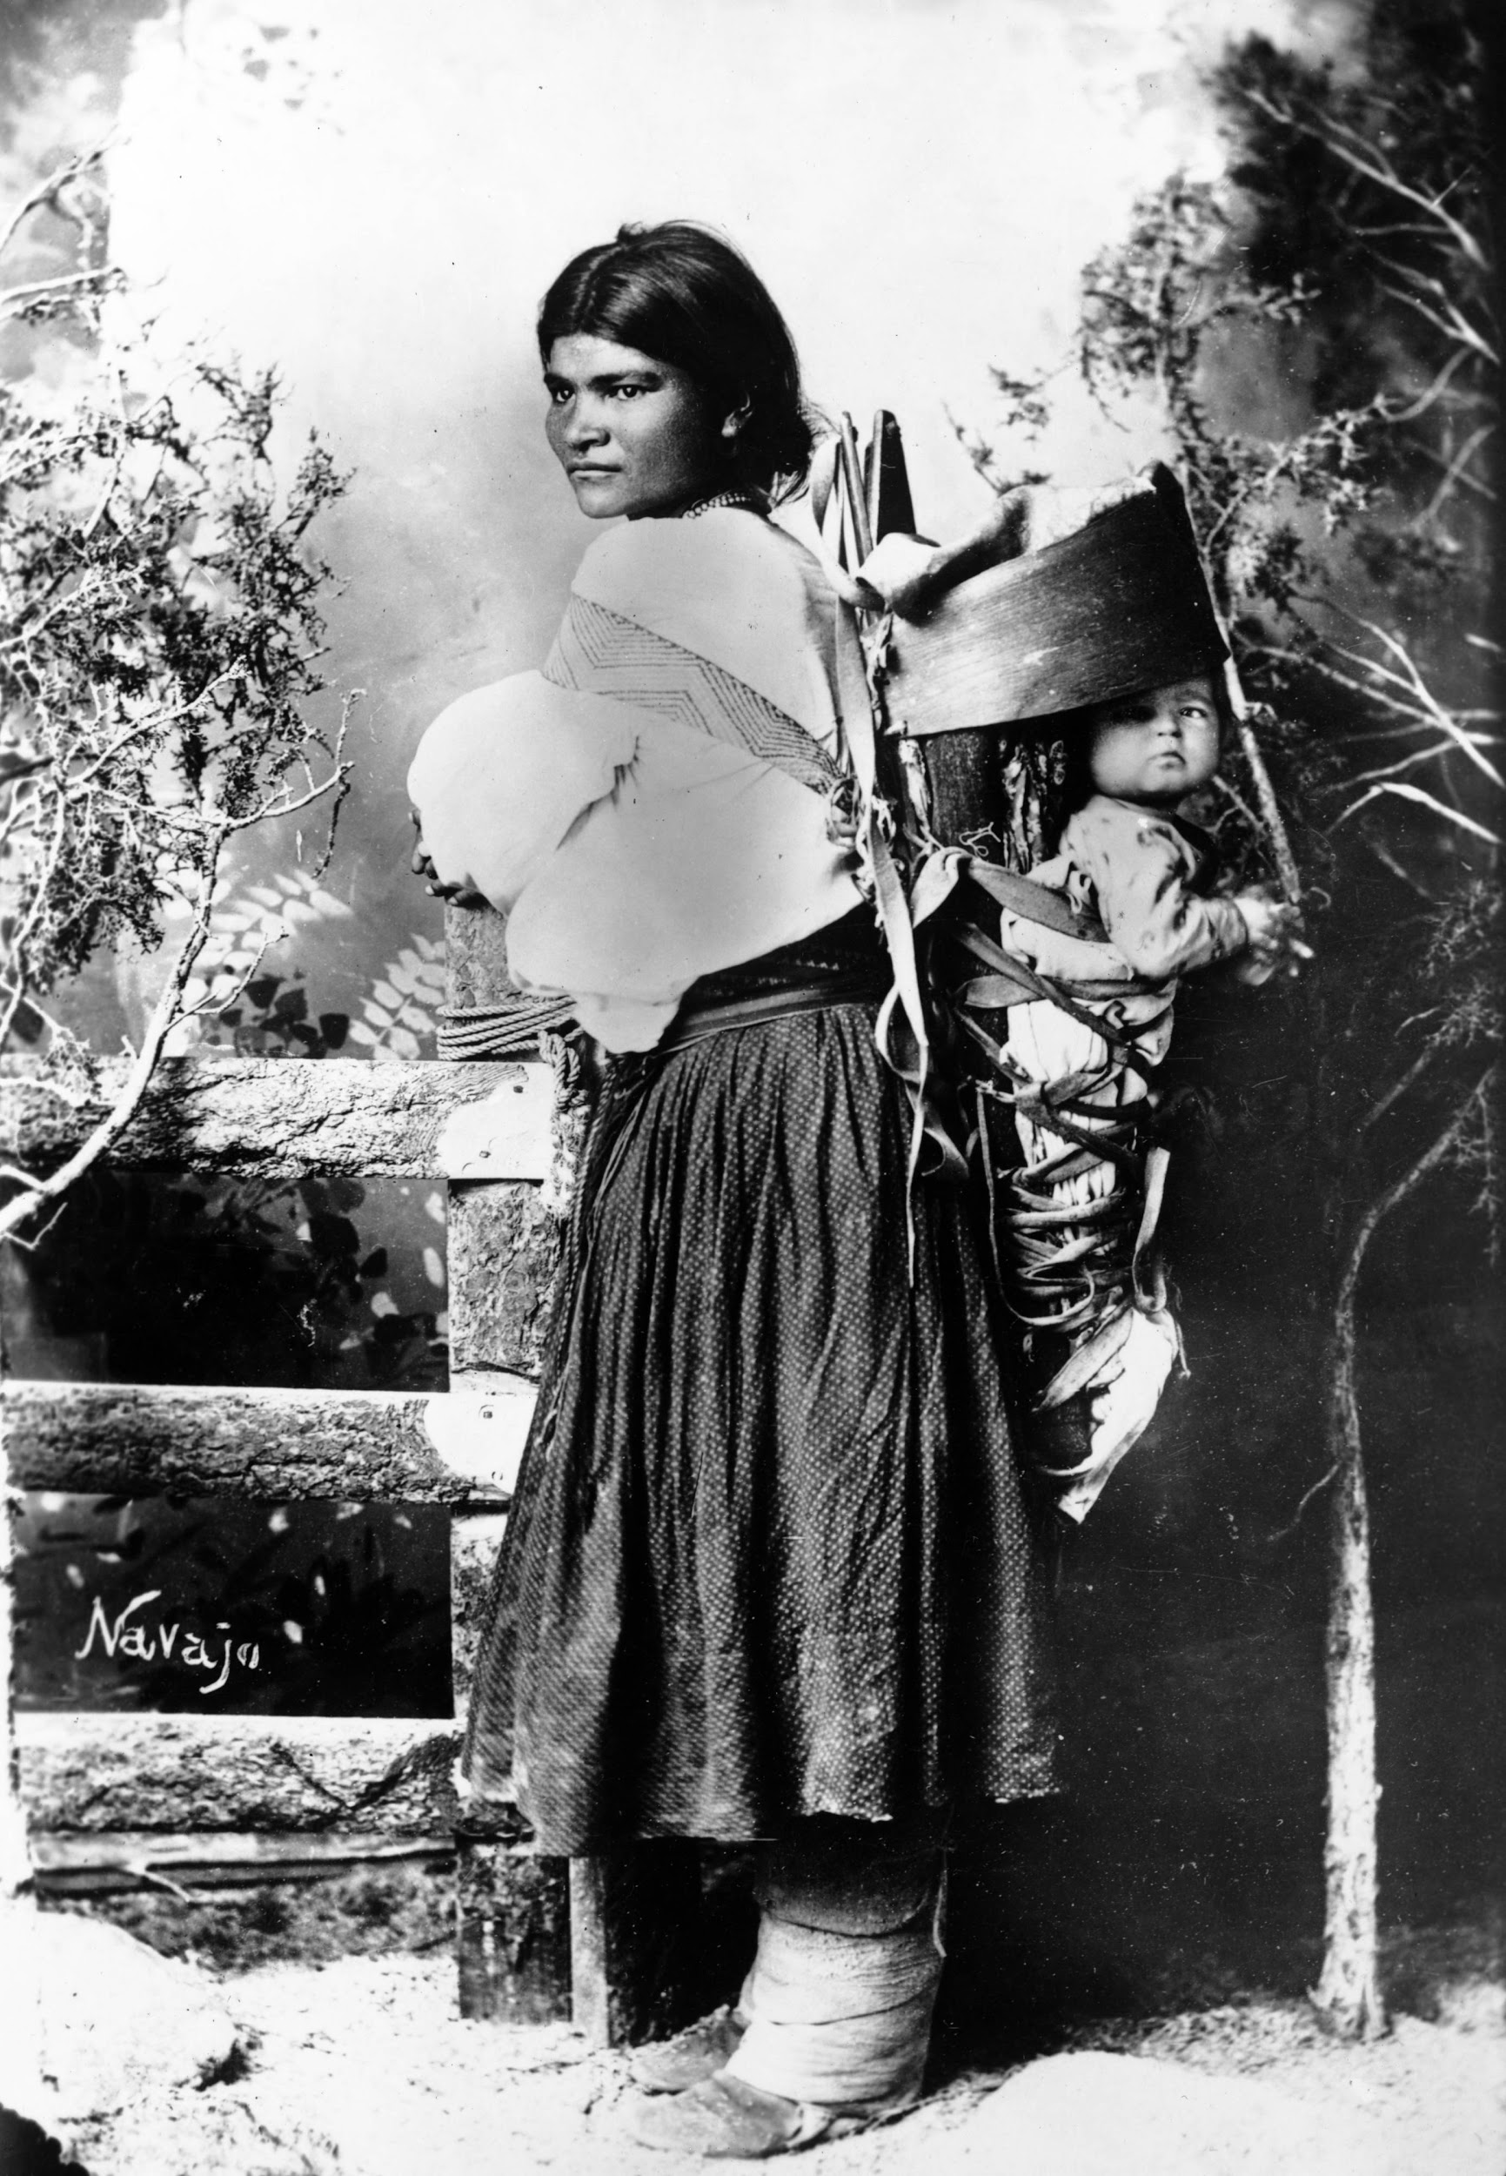
Pawnee Tribe Community By: oliver
men:
Hunters
sometimes went to war to protect their families
Only men became Pawnee chiefs
Women:
Farmers
did most of the child care and cooking.
Both:
Storytelling
Artwork
Music
traditional medicine

Slide 7
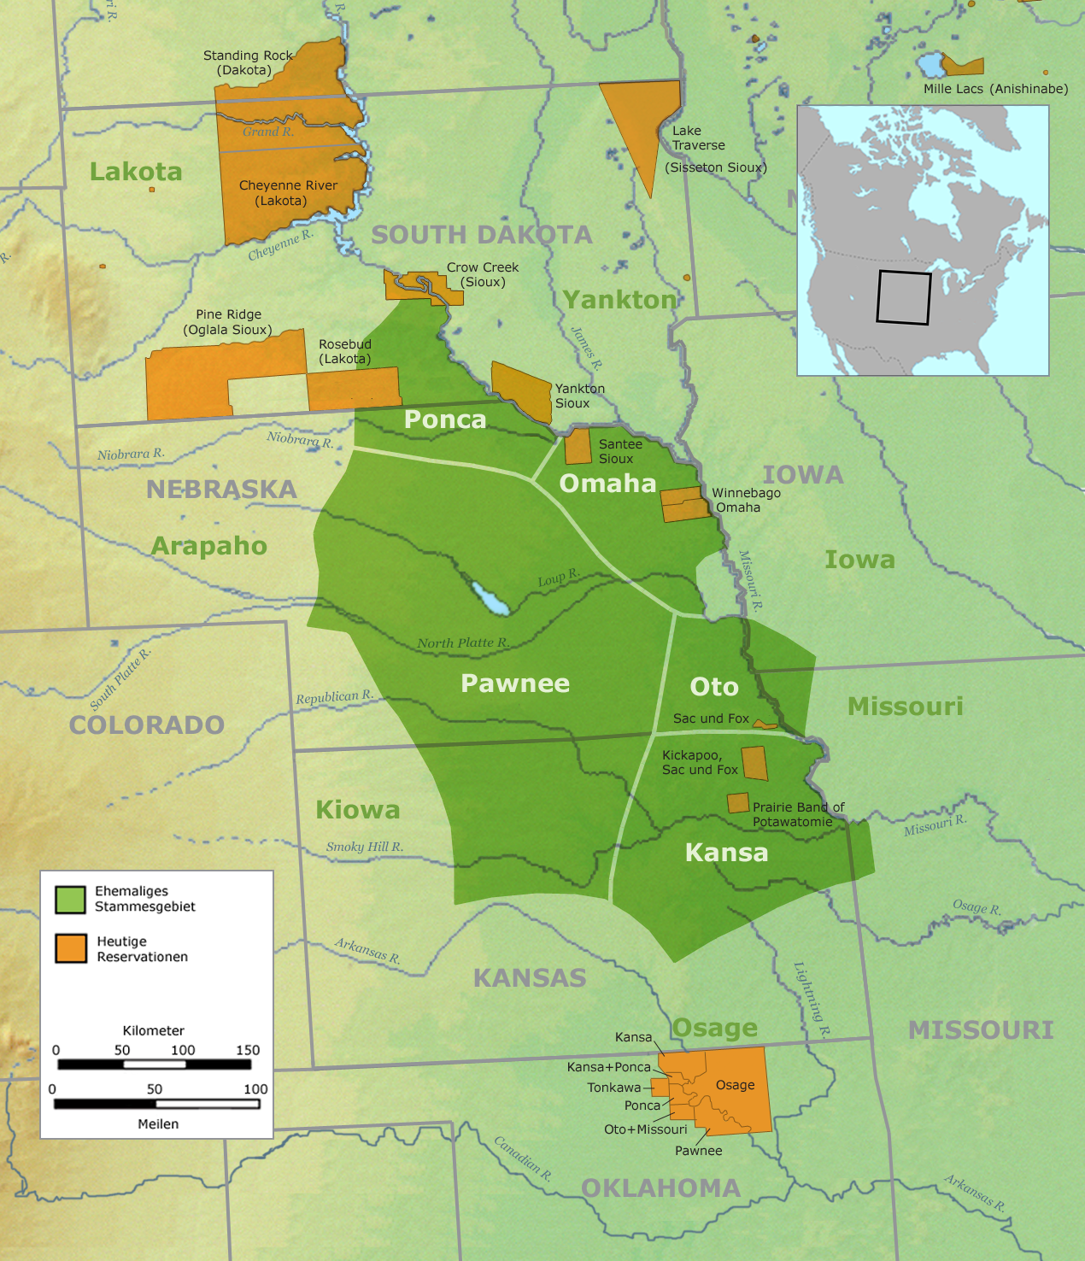
Geography By: Lila
Location: Great Plains area in what is today Nebraska and Kansas
Fun Fact: The tribes in the great plains used Plain Sign Language to communicate.
Climate: The Great Plains Region has a lot of wind, cold and harsh winters, and hot and humid summers.
Nearby Tribes: Comanche, Omaha, Oto, Kansa, and the Ponca

Slide 8
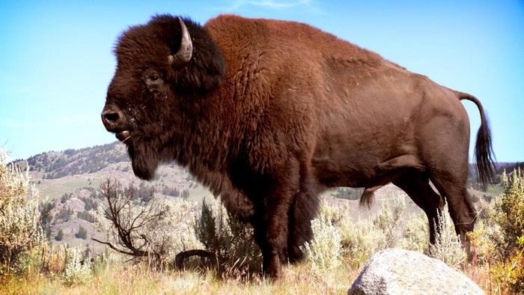
Food eaten by the Pawnee tribe made by Hilary Taylor
The Pawnee tribe got their food by hunting buffalo and other animals, planting and farming beans, corn, squash, and sunflowers, and gathering other nuts, seeds, and fruits from the forests. They ate this because it was available most of the seasons.
American Buffalo - The Animal Print Shop by Sharon Montrose
www.theanimalprintshop.com545 × 425Search by image
American Buffalo
Images may be subject to copyright.Send feedback

Slide 9
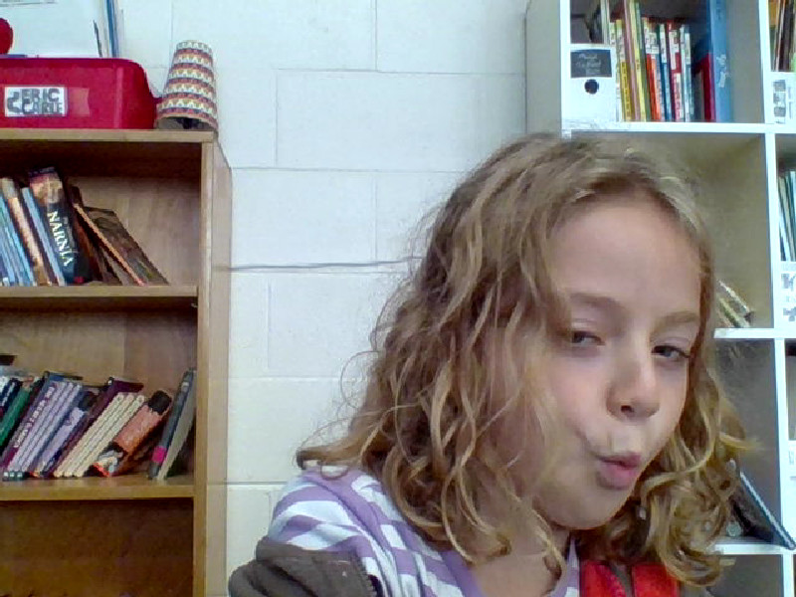
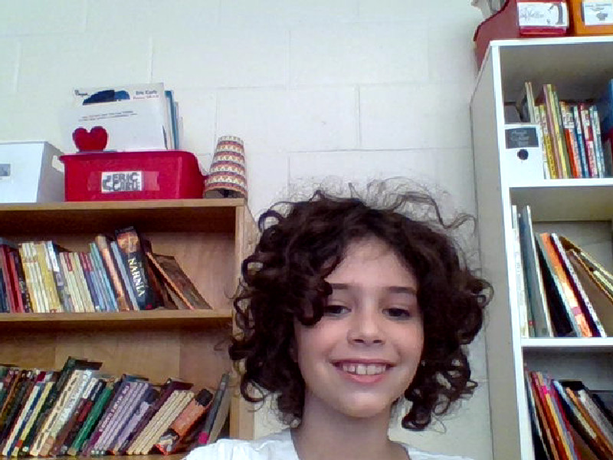
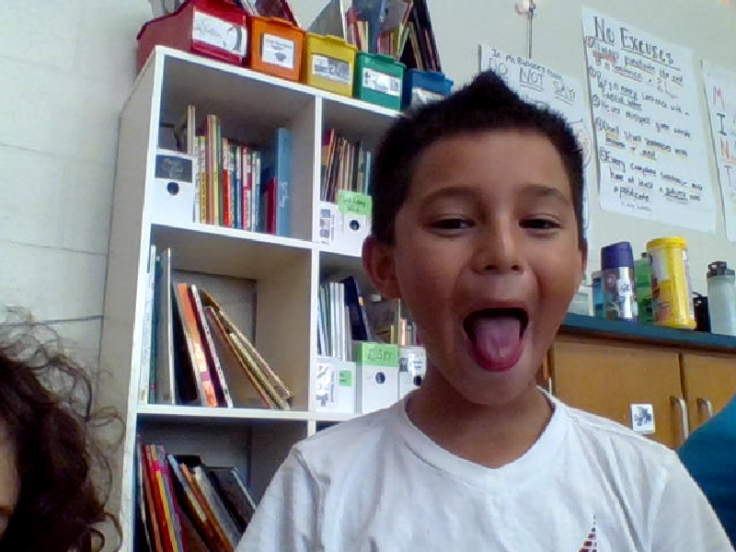
THE END
P.S Pawnee Tribe Is Awesome!!!!!!!!
.
THANK YOU FOR YOUR TIME AND RESPECT!
I HOPE YOU ENJOYED IT!

