Slide 1
The Nez Perce Tribe !!!
By Ellie,Luca,Molly, Briseyda, and Joe

Slide 2
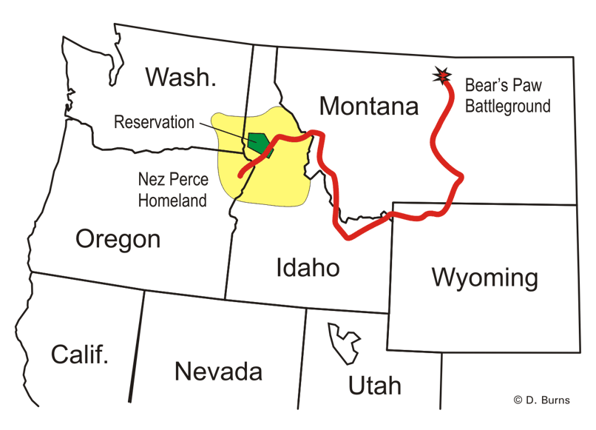
Geographer:
Joe Fahmy
Location:
EAST of the Kwakiutl tribe
Parts of eastern Oregon and Washington as well as the state of idaho.
PLATEAU
Features:
on the columbia plateau
between the Cascade Mountains (west) and the Rocky Mountains (east)
Between Columbia and Snake rivers.
topped mountains and hills
many rivers and streams
forests and grasslands.
Climate:
Winter: high humidity, moderately cold not as low as other northern state with high elevations.
Summers: hot and dry

Slide 3
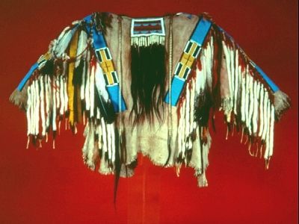
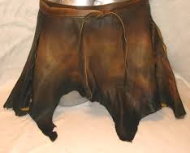
Fashion Designer: Molly Thompson!!!
men and boys: long fringed skirts, belts, and moccasins (leather shoes)
women and girls: long deerskin dresses, corn husk hats, and knee-high moccasins.
Dresses and warrior’s skirts were fringed and often decorated with beadwork, shells, and painted designs.

Slide 4
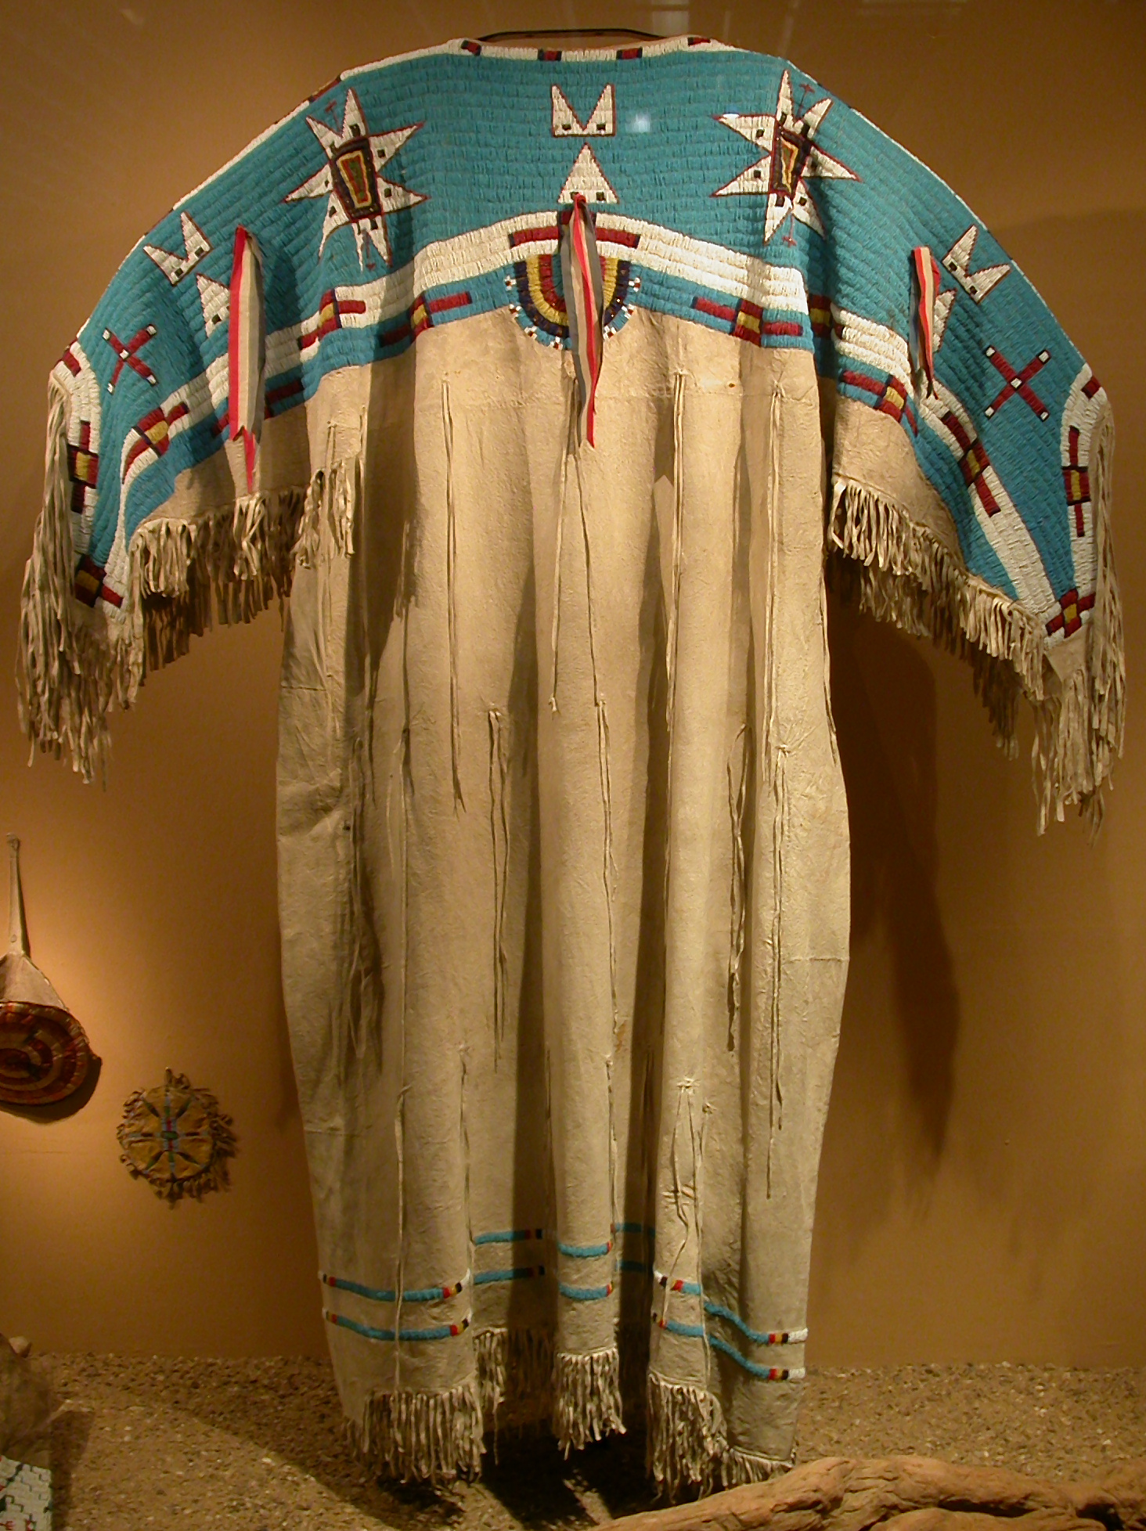
Fashion designer: Molly Thompson!!!
The Nez Perce tribe used plant materials, hides, feathers, and animal fur to make their clothing.

Slide 5
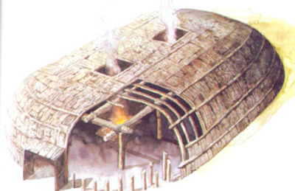
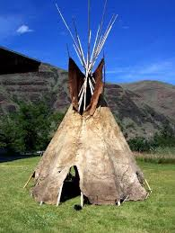
Real Estate Agent: Ellie Challas!!!!!
The Nez Perce tribe mostly lived in dome-shaped houses made from earth materials called earth houses. These were permanent homes.
They sometimes lived in tepees, but only when they hunted and needed to move around to follow buffalo herds.These houses were temporary.

Slide 6
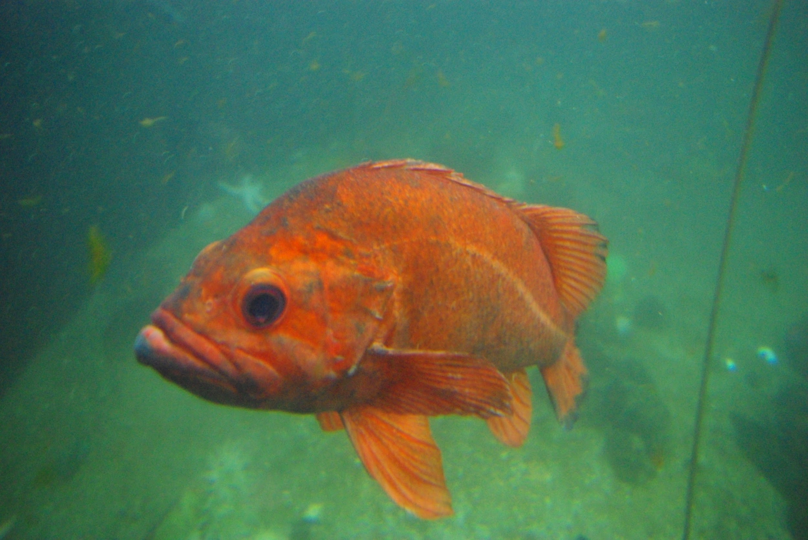
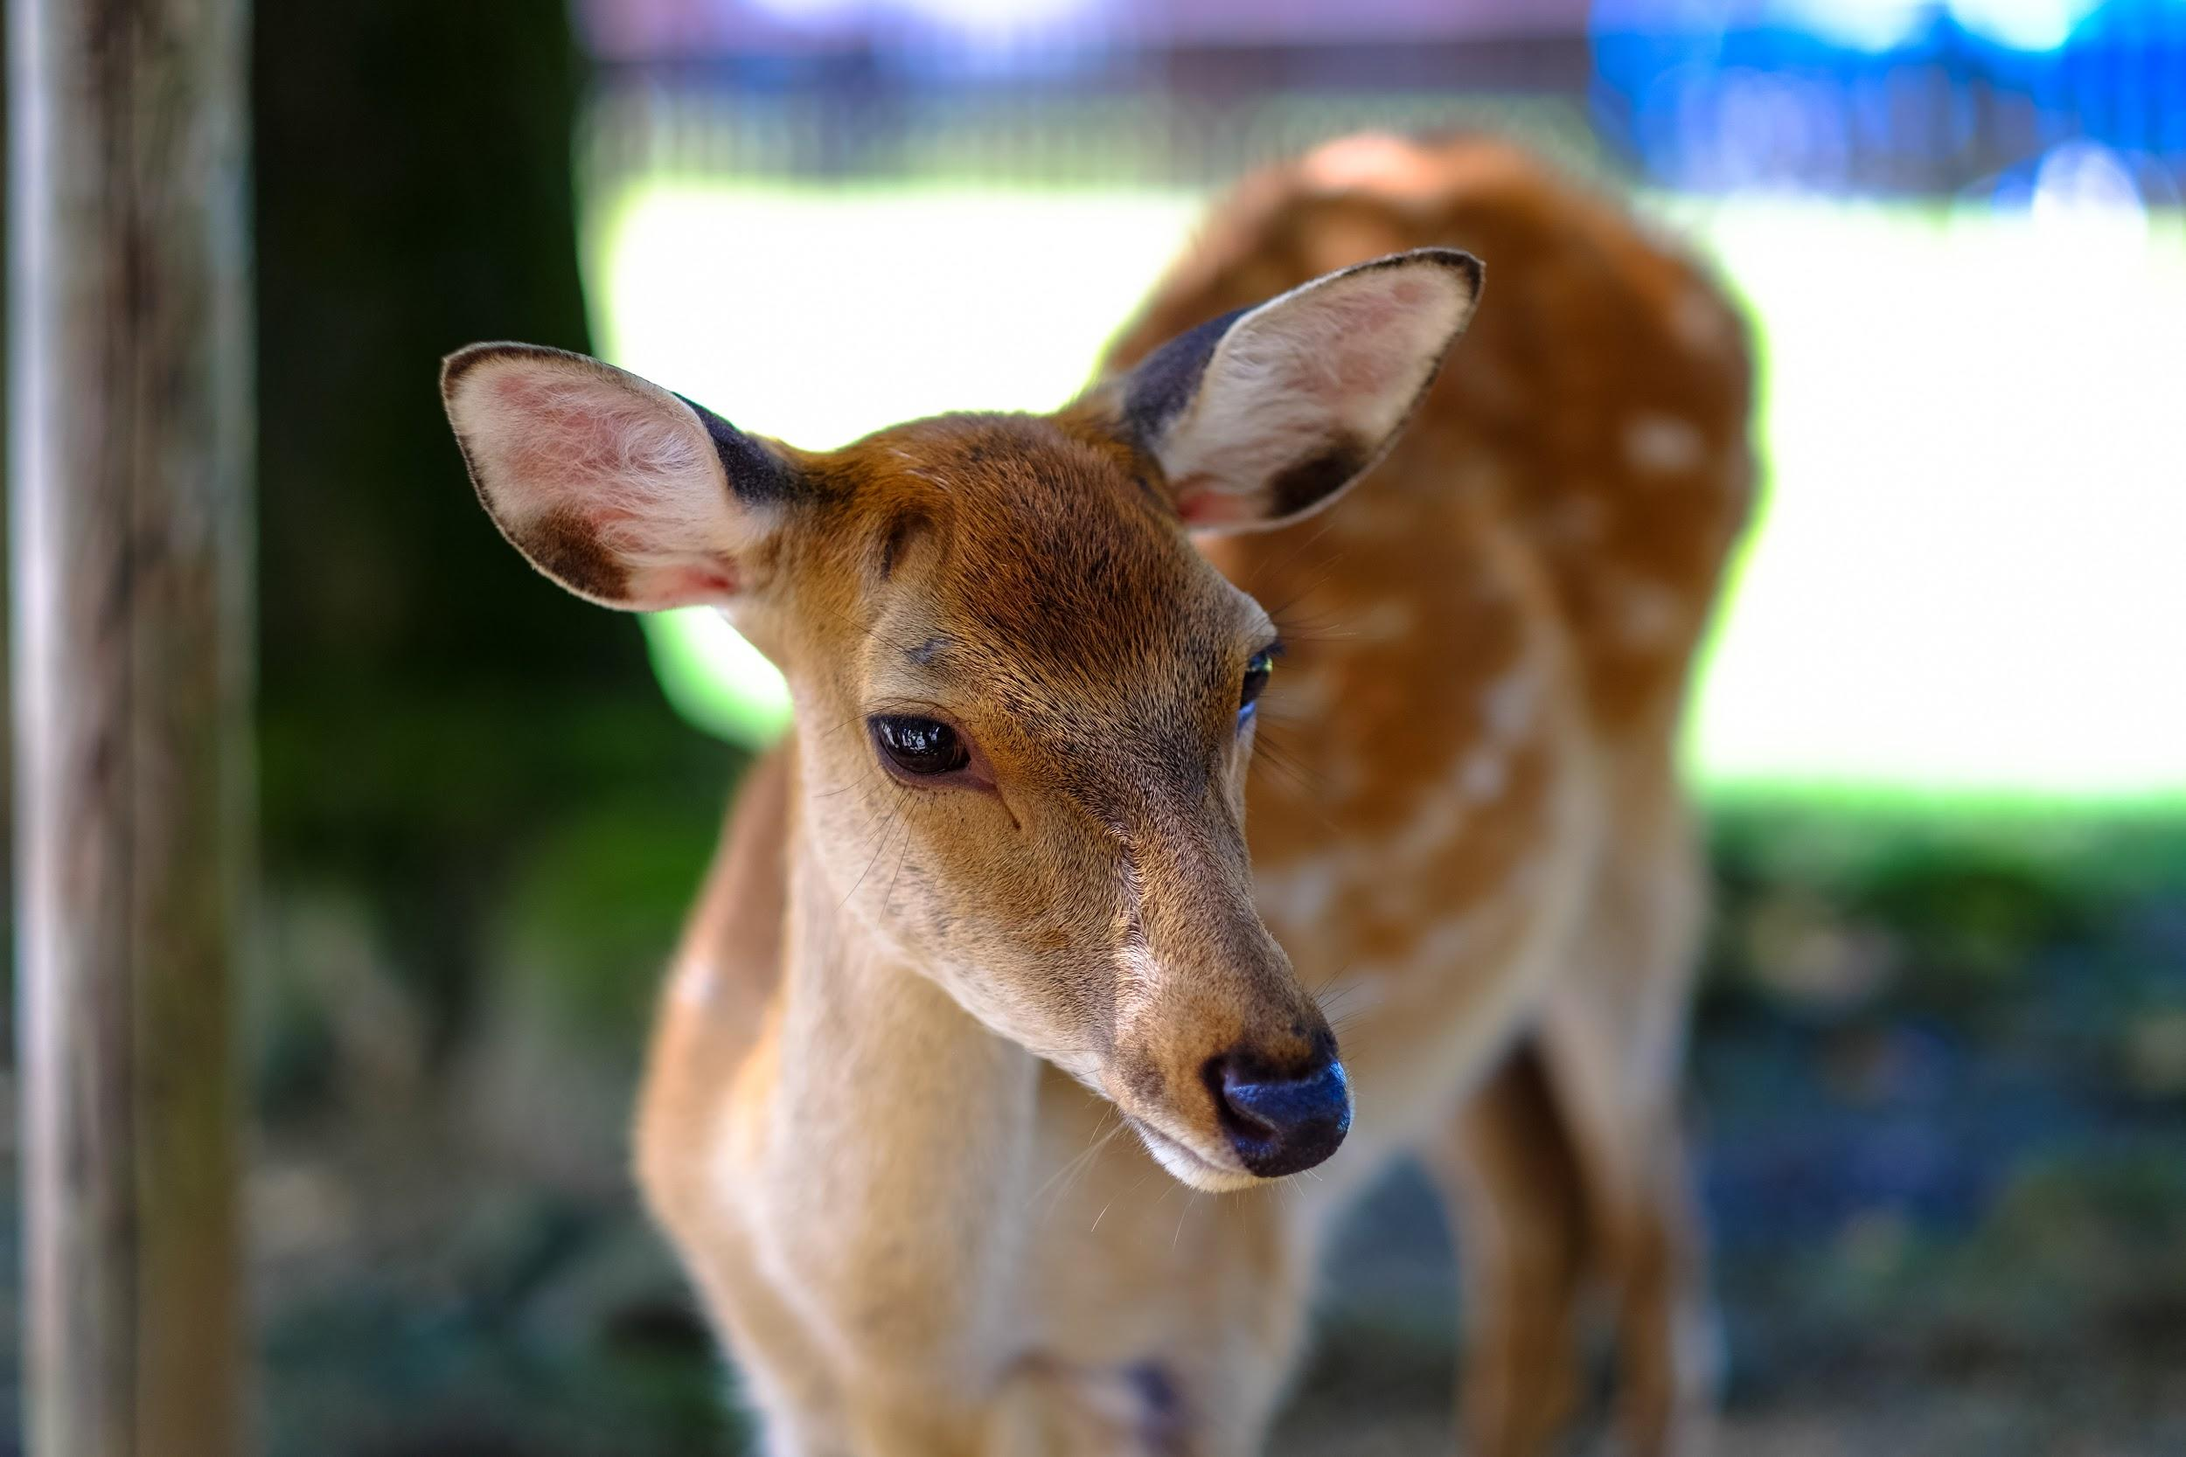
Food by briseyda
The Nez Perce got their food from hunting, gathering, and fishing.
Men made long spears and nets to catch salmon and other fish.
They also hunted in the forests for deer, elk, and other game.
Notes:
Riing

Slide 7
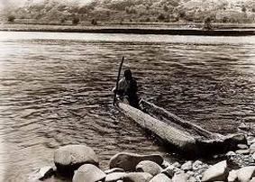
Community Resources by Luca
children: learned skills from adults, but played with each other, too
Men: hunt and fish
women: provide medicine, clothes, and gather and prepare fruits and vegetables
transportation: canoes

