Slide 1
Kwakiutl tribe
By: Chloe, Arte, Liam ,William, Grey,

Slide 2
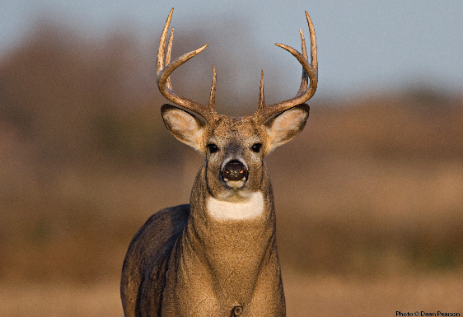
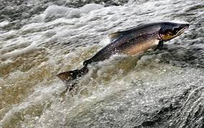
Food by: Arte The Owl
woman gathered herbs and vegetables like: corn, pumpkin, lettuce, roots, mushrooms ect.
men hunted for things like: salmon/fish in nearby river and birds, deer, bears, chicken, wolves in nearby forest

Slide 3
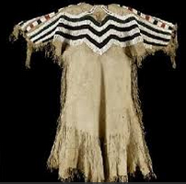
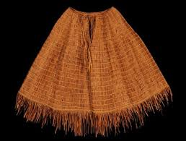
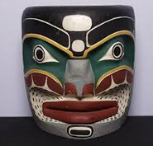
The Clothes by: Chloe
The Kwakiutl tribe indians used deerskin and deer fur for their clothing. Also they used turkey feathers for their headbands. For their earrings they would use fish skin. For their shoes, they would use pieces of wood for the bottom and plants for the top. In colder weather both genders wore knee length tunics, long cloaks of shredded cedar bark and moccasins on their feet.

Slide 4
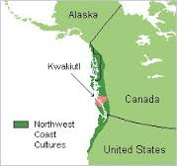
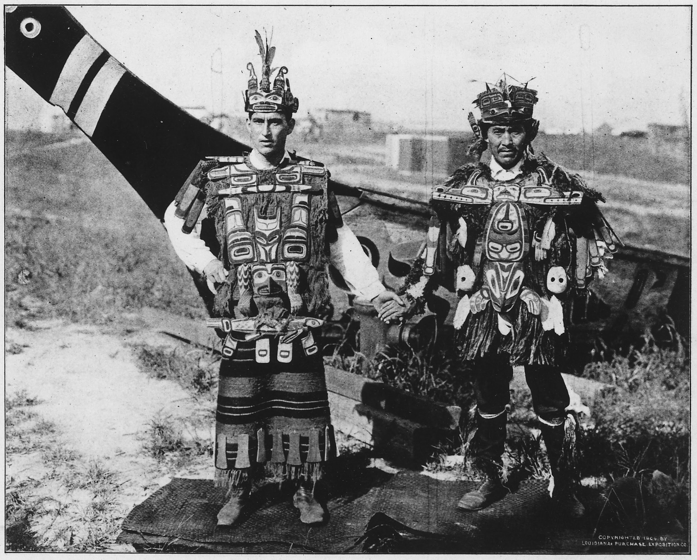
Geography by : Grey Steele
Location: Pacific Northwest coast of what is now the United States, stretching from Alaska to Oregon and even northern California!
Nearby tribes: Haida, Makah ,and Chinook
Climate: mild/warm in the spring and summer, moderately cold in the winter, wet year-round

Slide 5
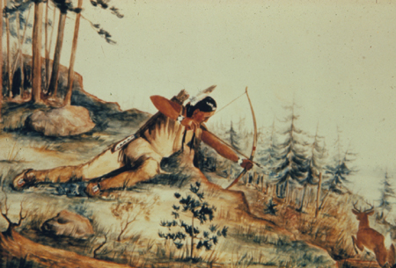
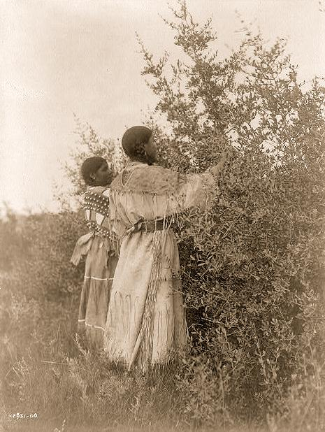
Community Resources by: Liam
Men: fished and hunted deer and small game.
Women: collected clams, berries, herbs, and other edible plants in their area. they also took care of the children and cooked.
Both: storytelling, artwork, music, and traditional medicine.
Kwakiutl chief was always a man
clan leaders could be either men or women.

Slide 6
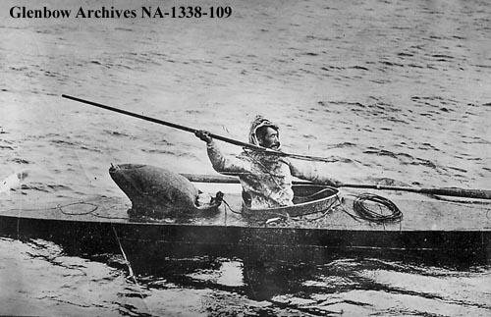
Community Resources by: Liam
Transportation:
large dugout canoes from hollowed out cedar logs
used canoes to travel up and down the sea coast for trading, fishing, hunting, and warfare.
most impressive war canoes could be more than sixty feet long and withstand ocean storms, were bought from the nearby Haida tribe who had better cedar trees

Slide 7
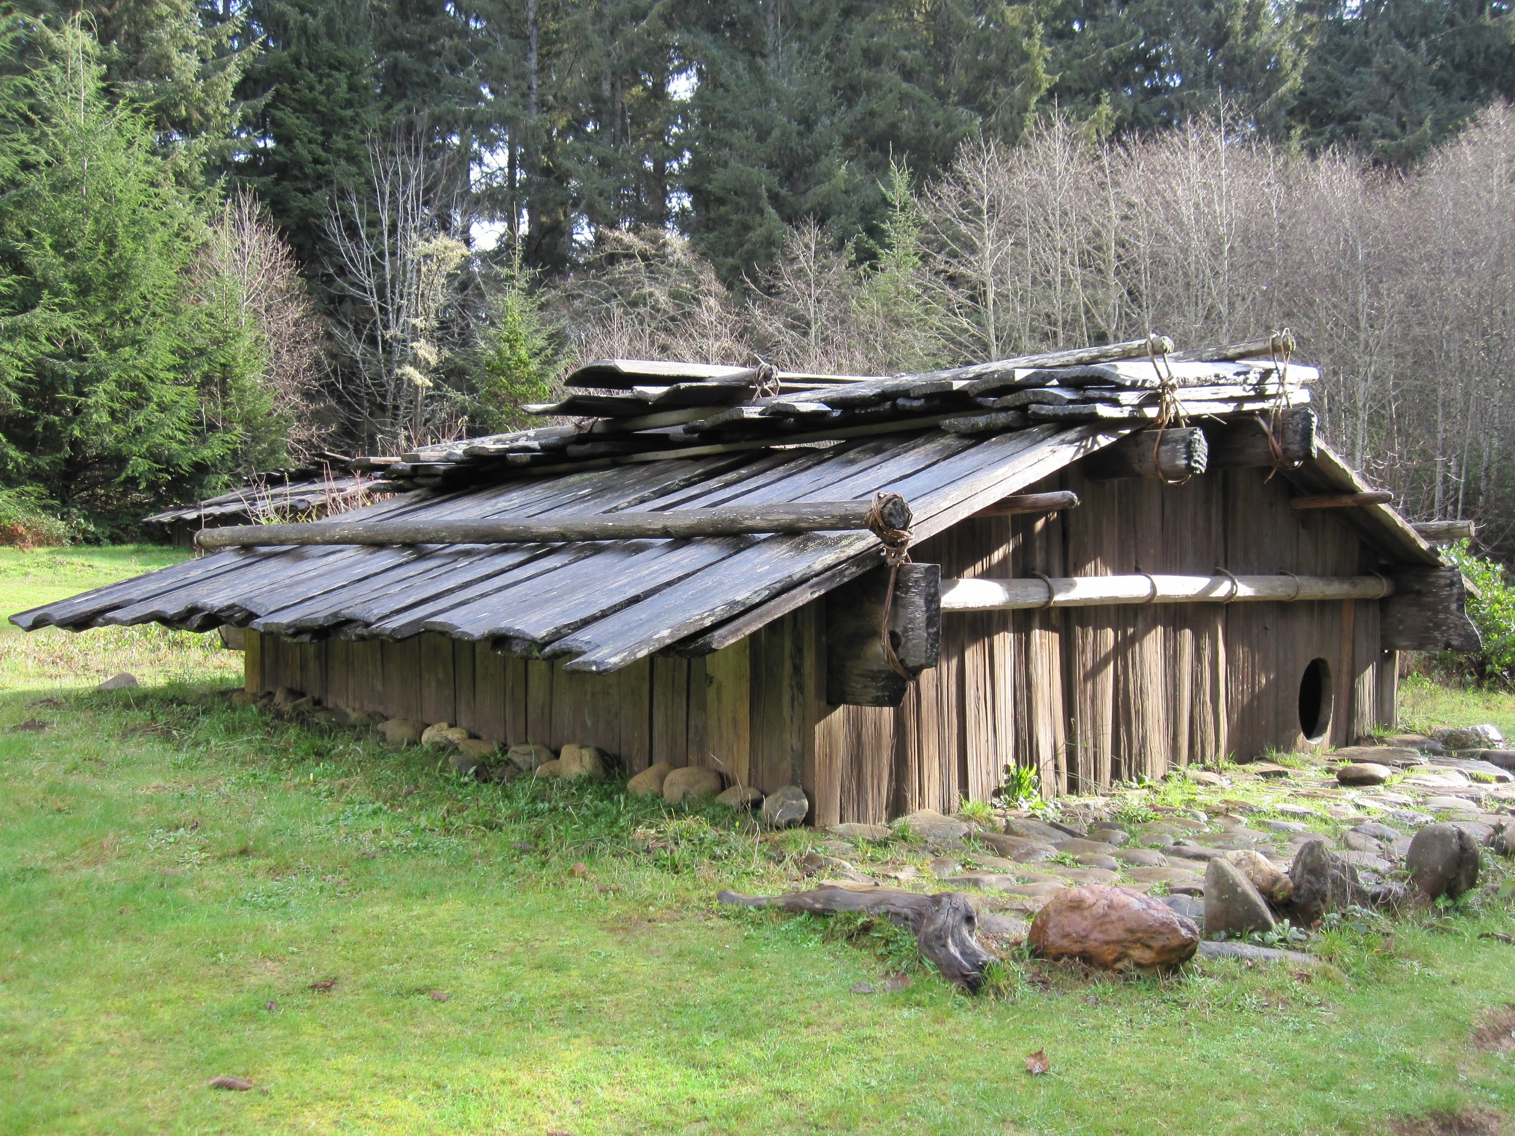
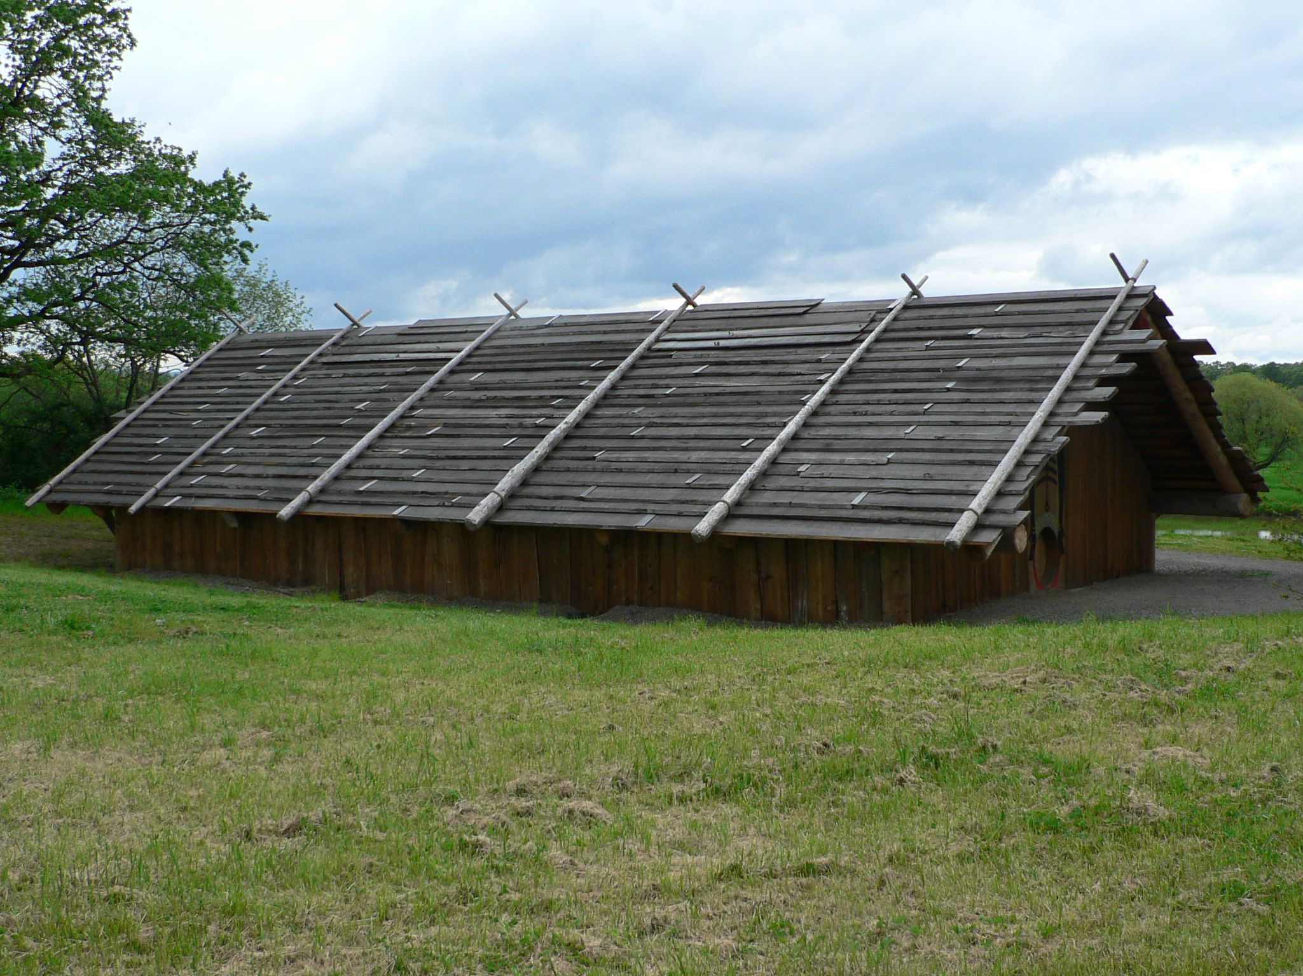
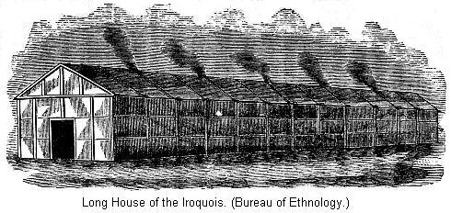
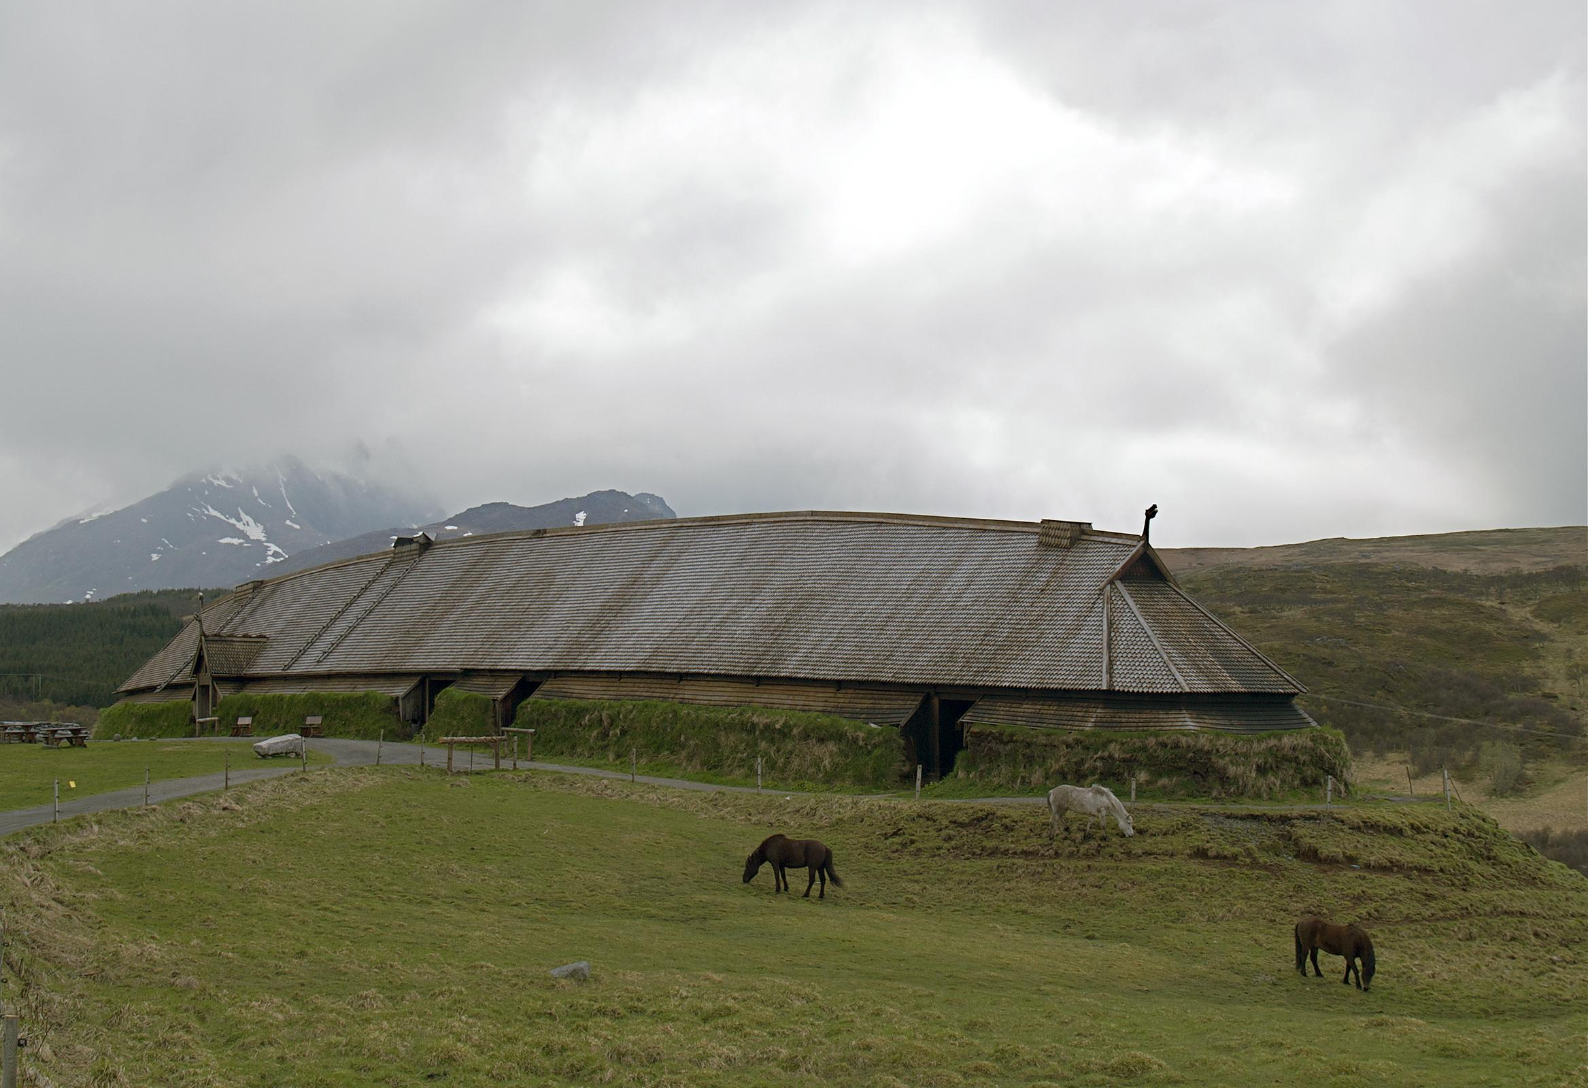
Kwakiutl Homes by: William Hutchison
The Kwakiutl tribe lived in coastal villages in rectangular cedar plank houses with bark loots called longhouses. Each household held several families. The homes were permanent. They were up to 100 feet long. They often painted them with bright colors and designs which stood for the family’s clan.

Slide 8
The End
I hope you enjoyed the slideshow

