Slide 1
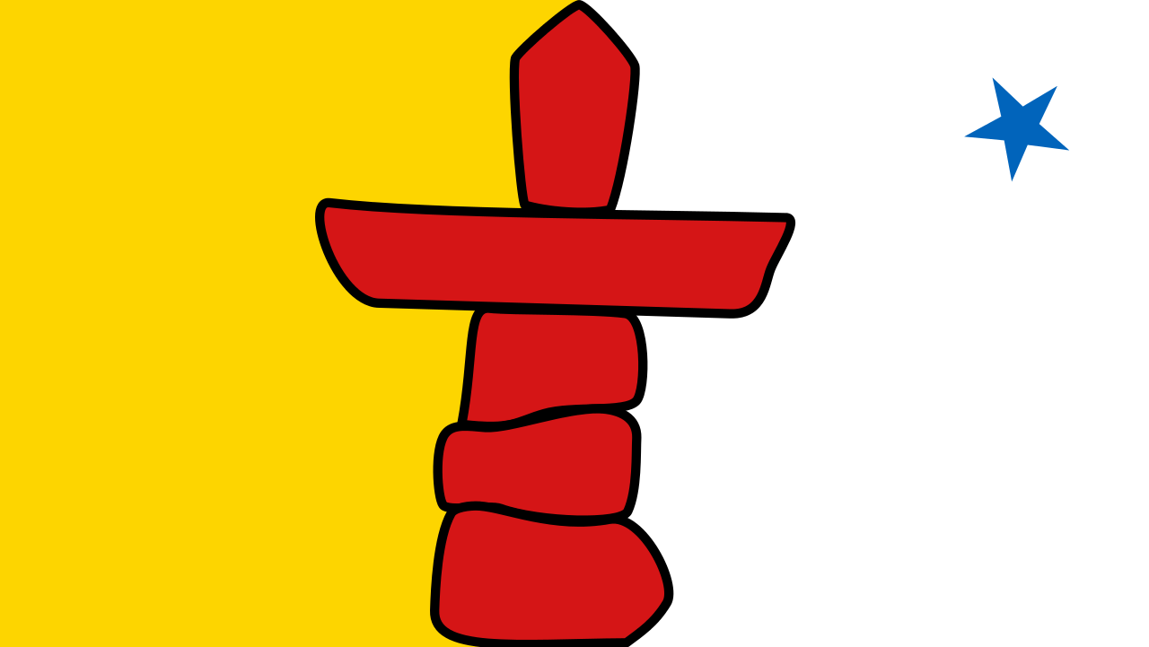
Inuit
Armanda, Ben, Emma, Rebecca, Angel

Slide 2
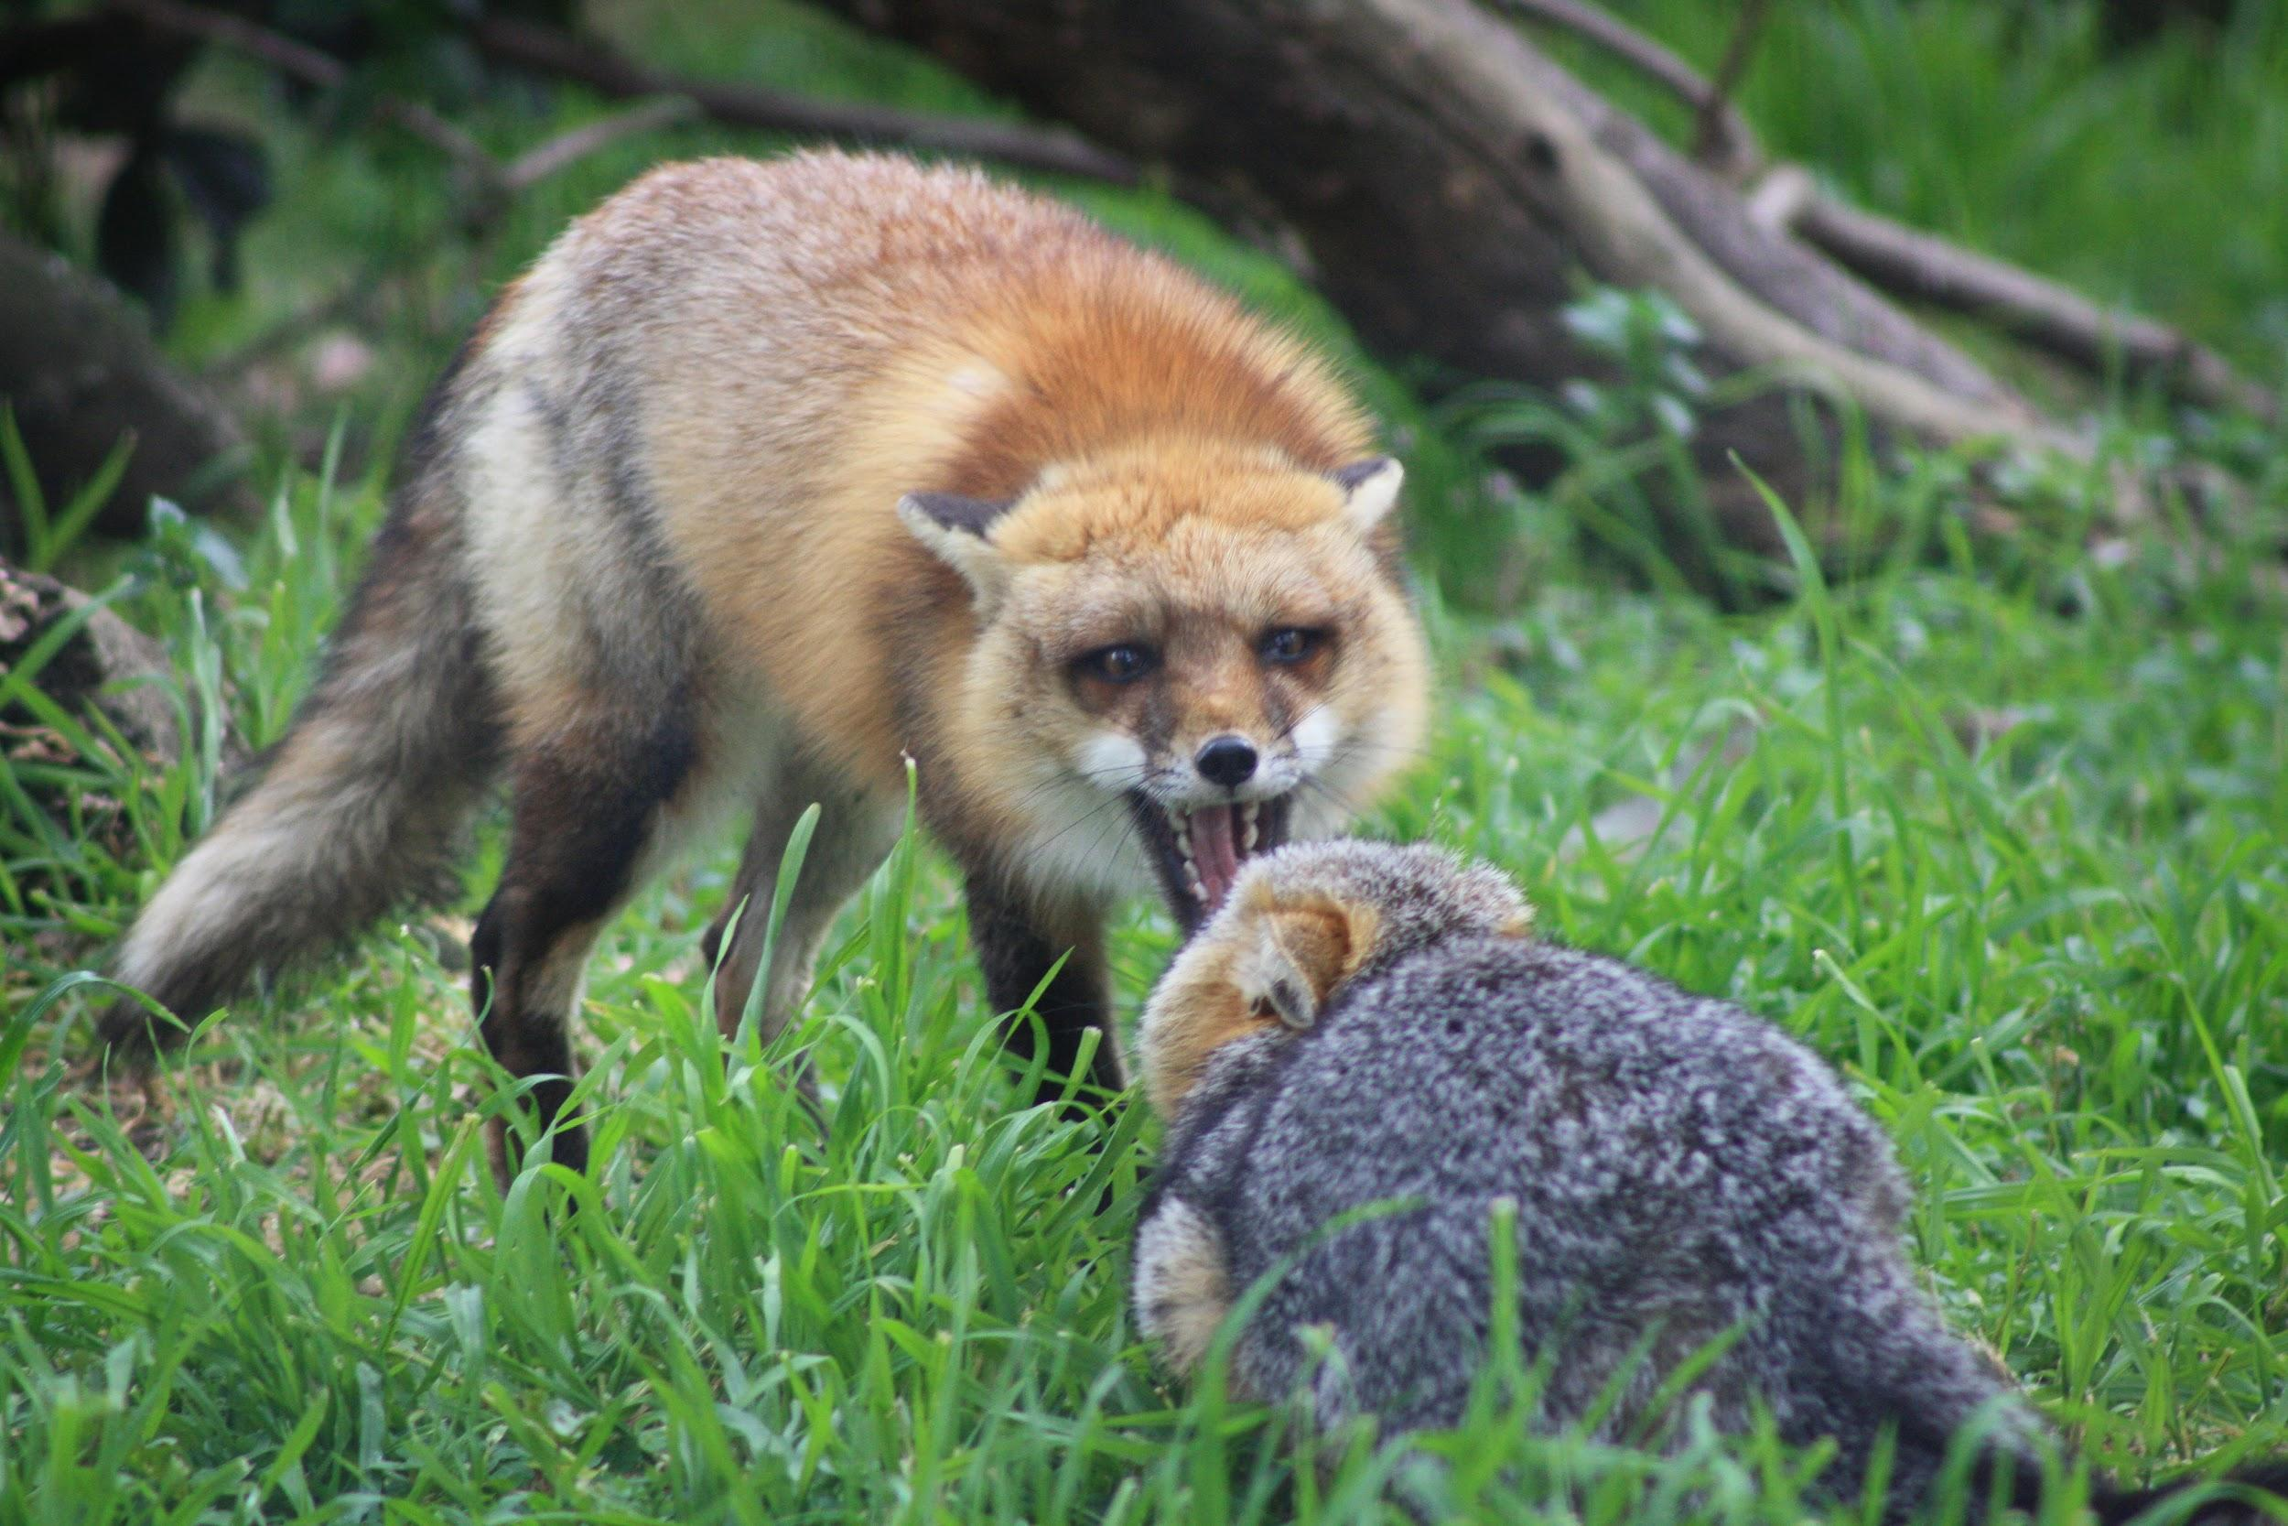
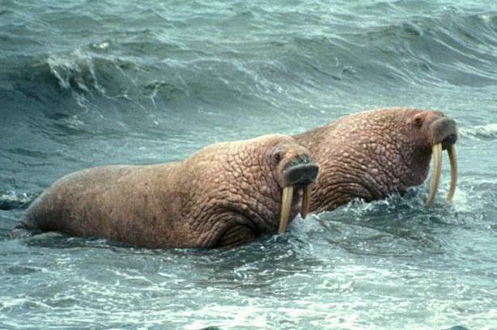
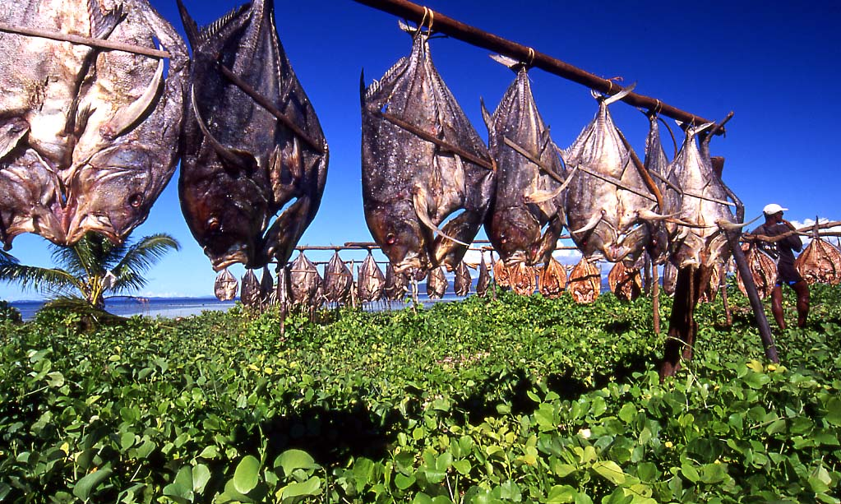
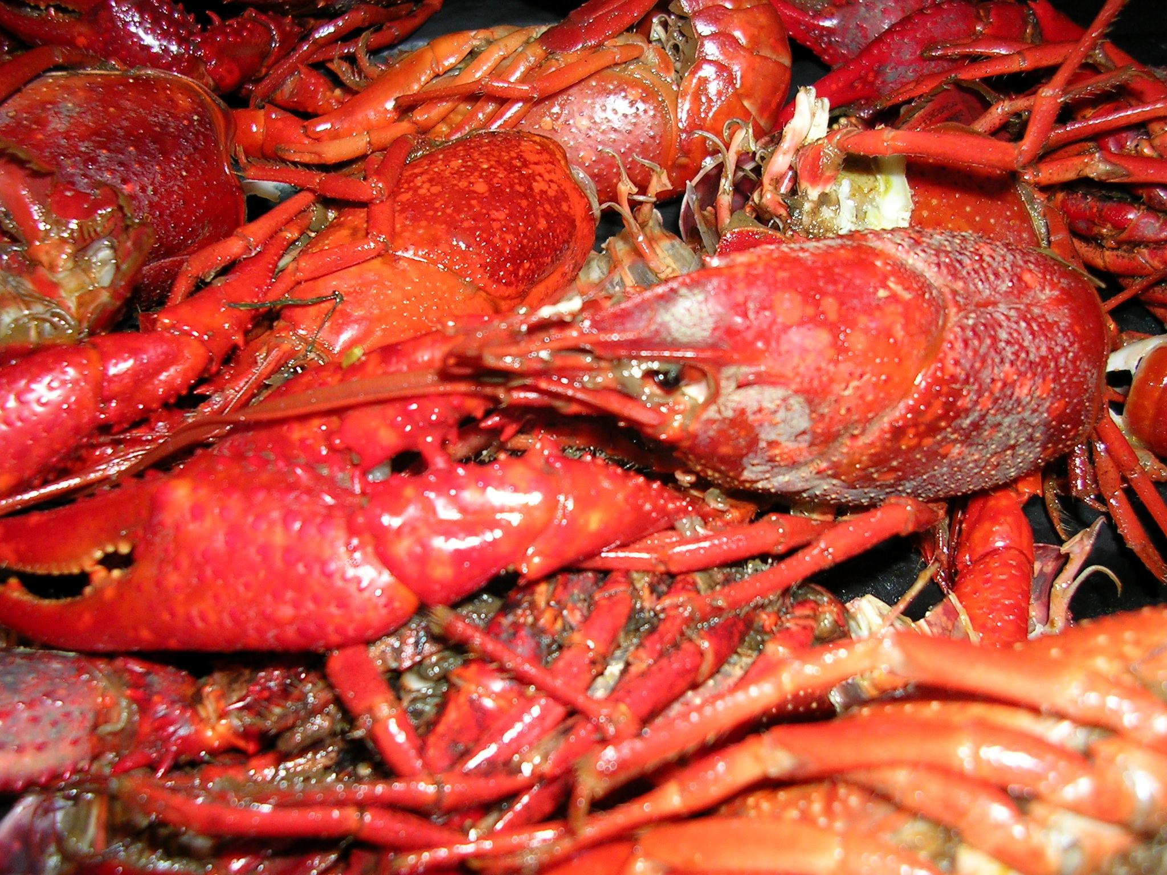
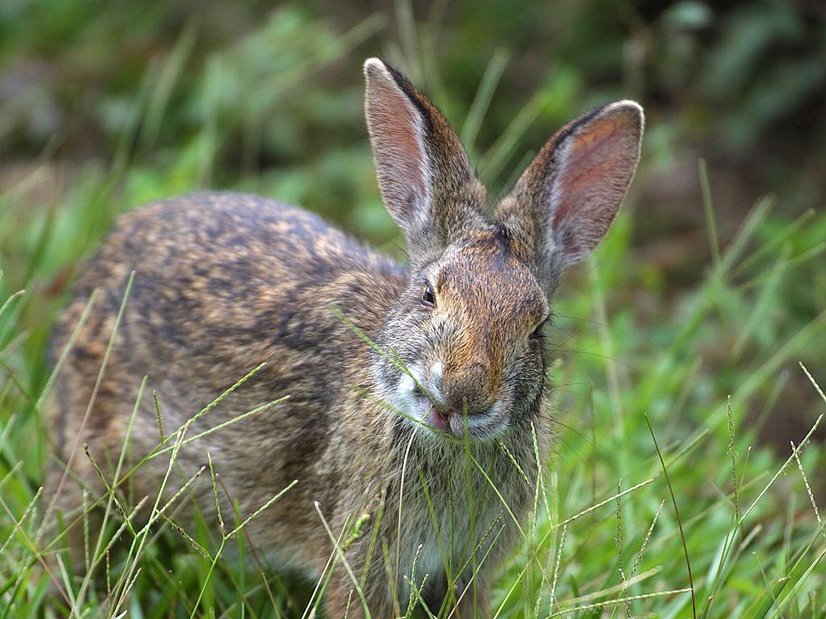
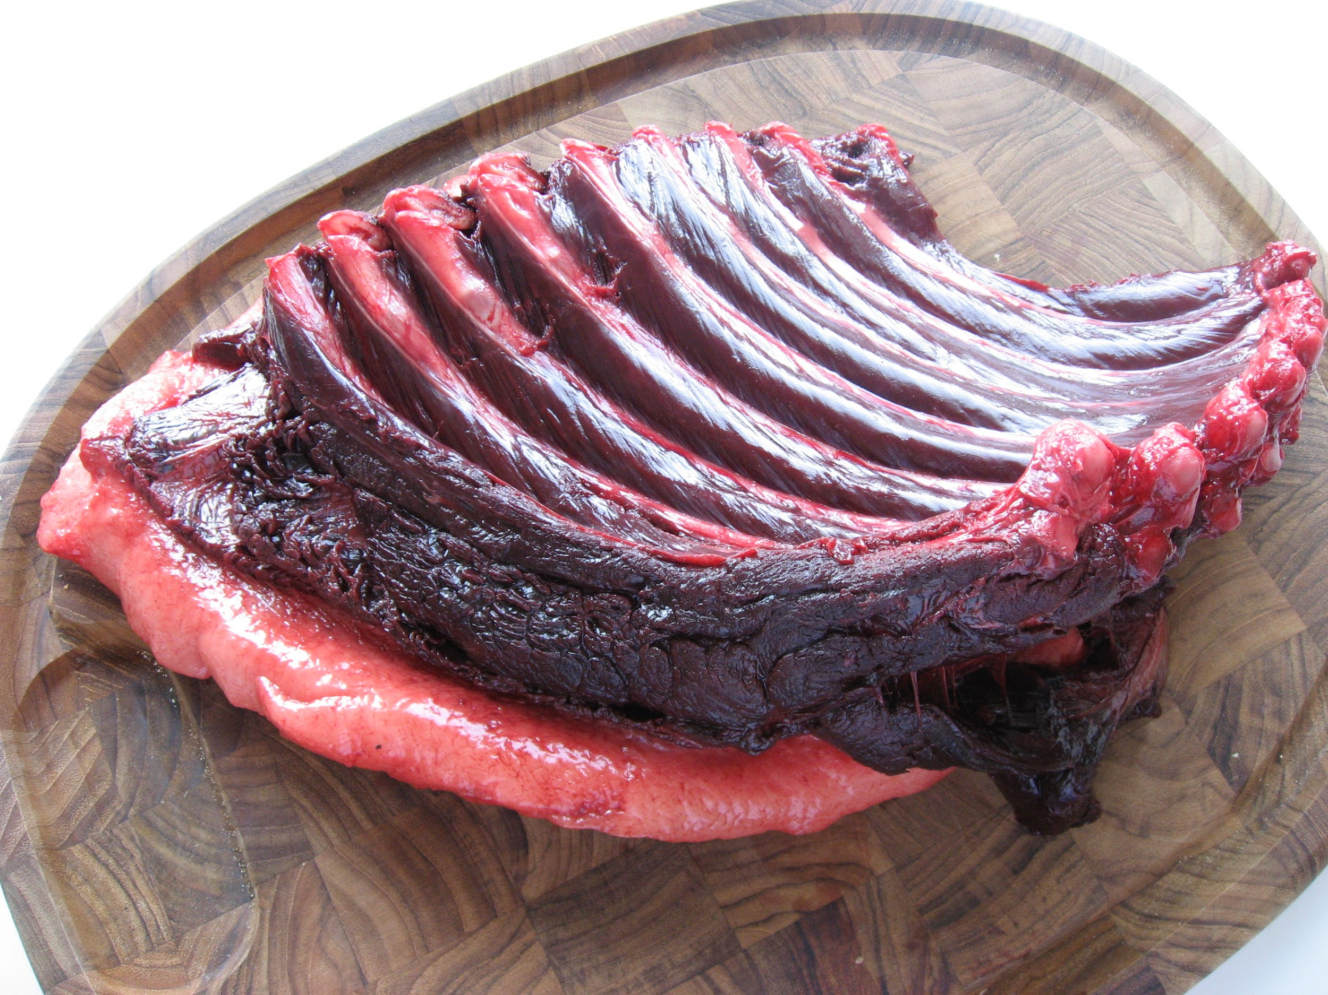
Inuit Food ( by Armanda!!!! )
What did the Inuit tribe eat?
They ate fox, seals, polar bears, birds, caribou, fish, whales, walruses, belugas, crabs, moose, duck, quail, and geese

Slide 3
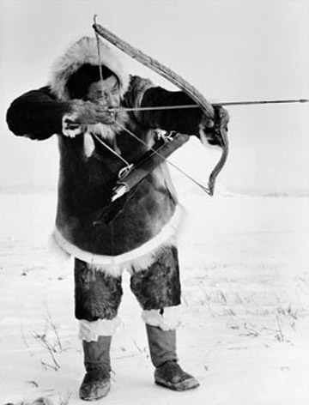
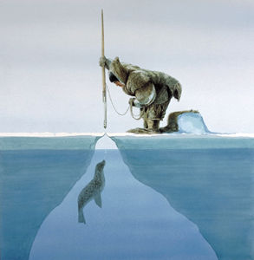
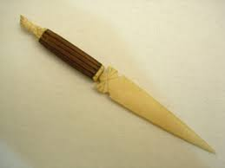
Inuit Food (continued) by Armanda
Why did the Inuit tribe eat this food? They ate this food because it is what was available to them. They did not have many crops to eat because it was too cold to grow them.
How did the Inuit tribes get food?
They hunted with hand made weapons, like bows and arrows, harpoons, and bone knives

Slide 4
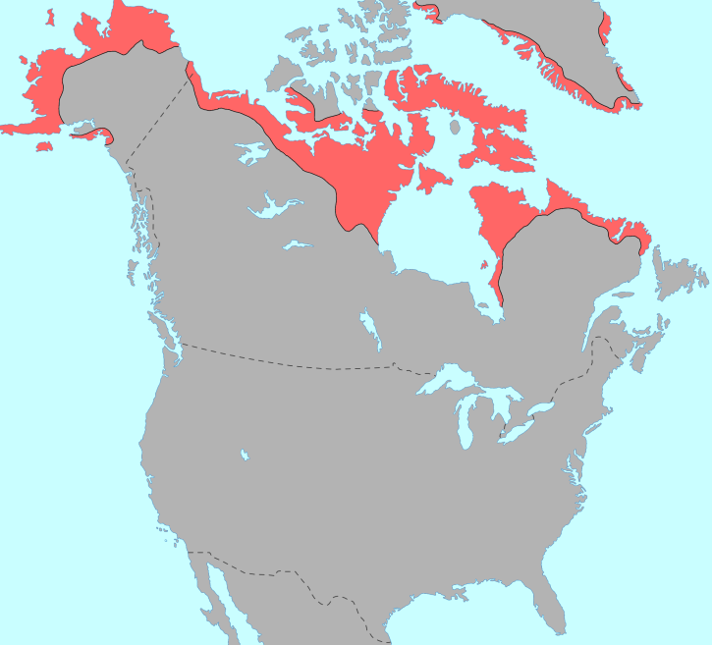
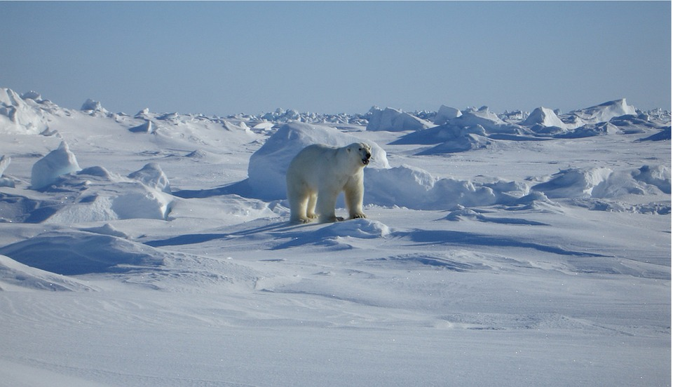
Location by Emma
The Inuit tribe lived in the cold arctic
Their land stretched across what is now Alaska and Northern Canada.
They lived on mostly flat plains that always stay frozen.
The climate is cold and wet.
Some other tribes nearby are Aleut and Tlingit.

Slide 5
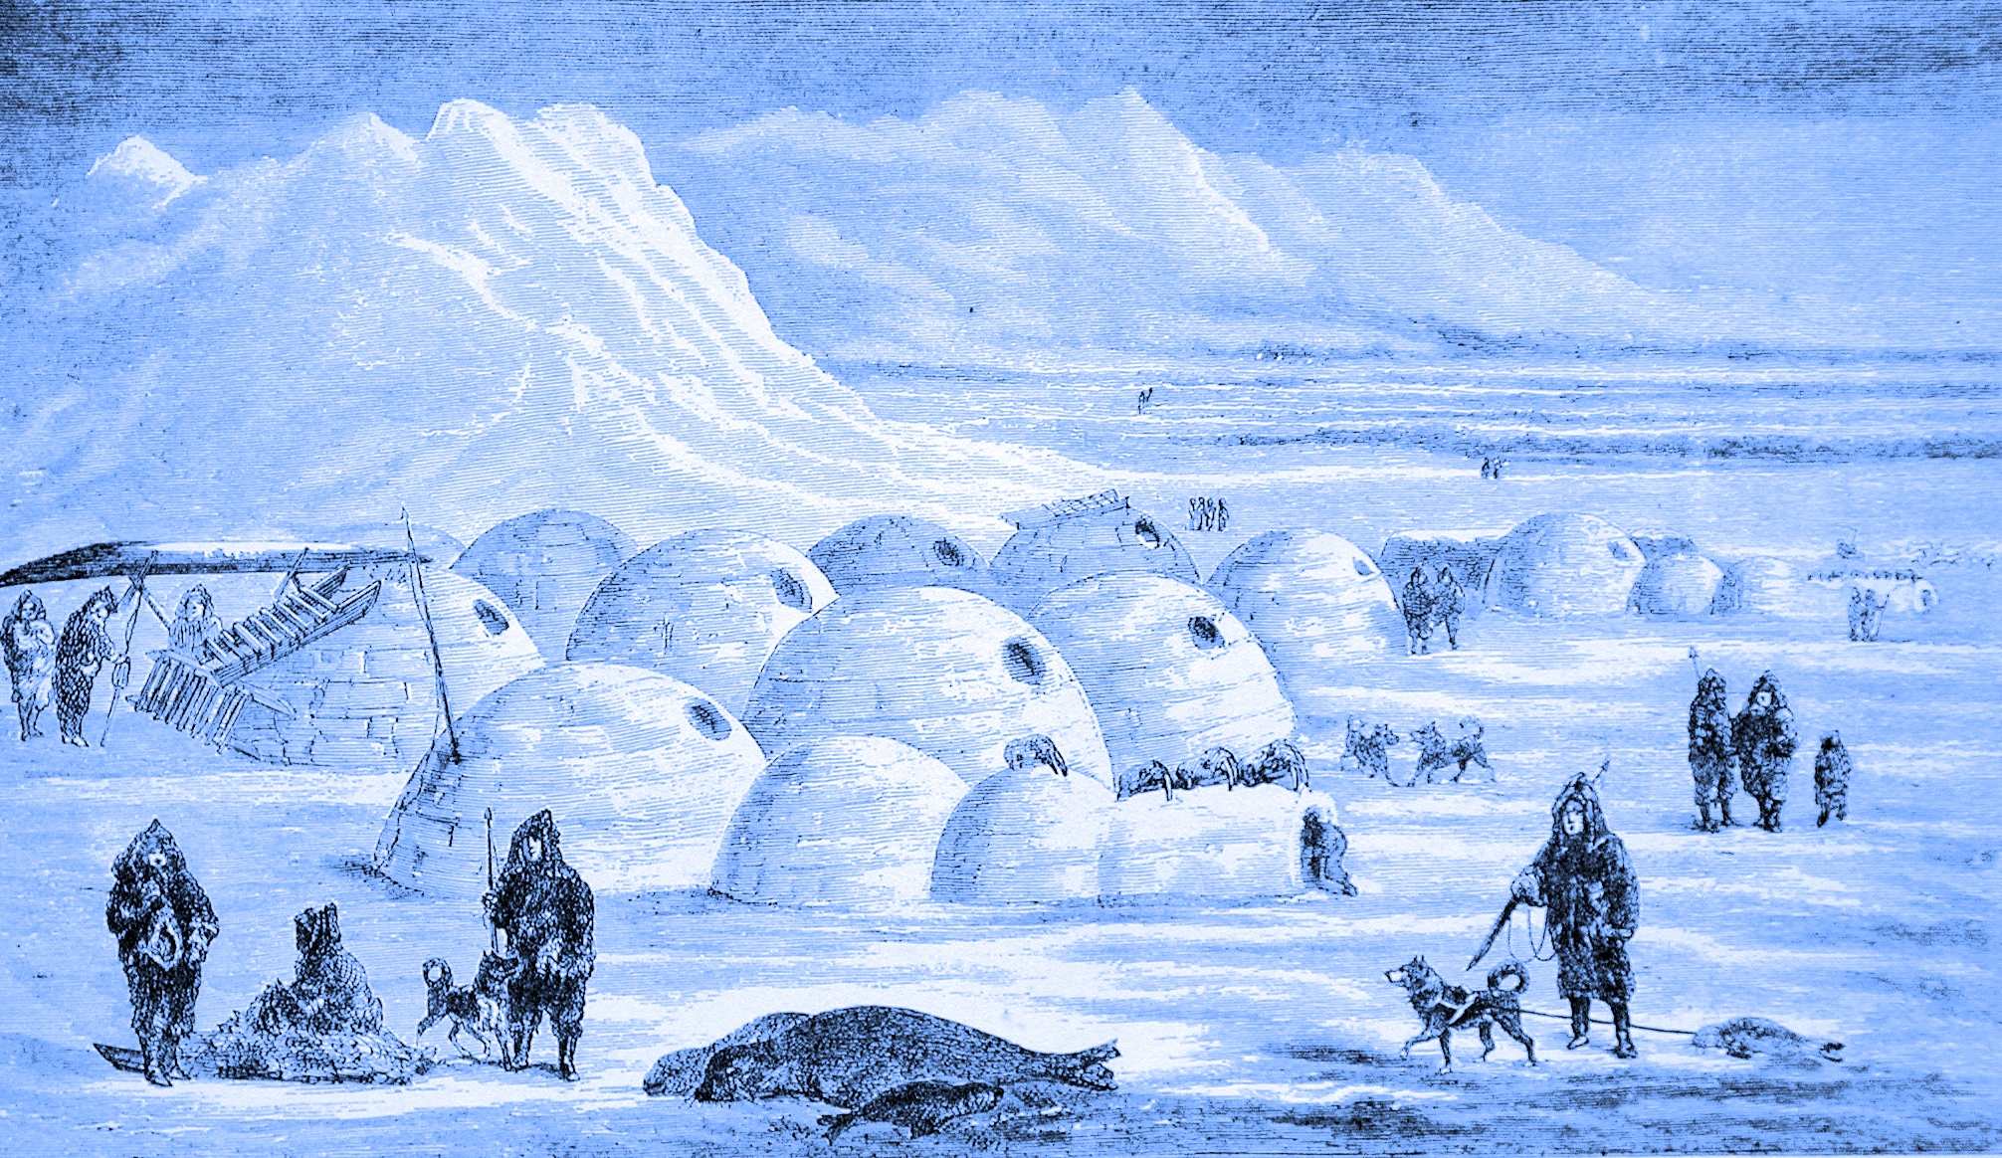
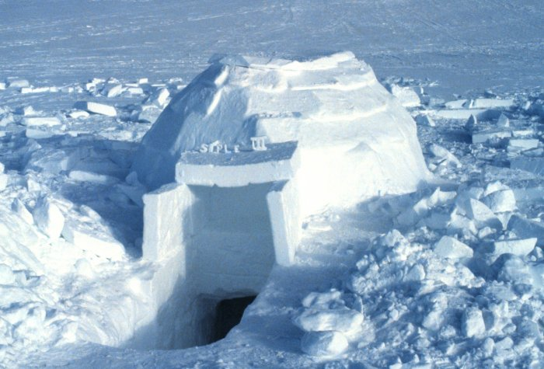
Ben
INUITS!
HOUSES!
The Inuits built hard ice igloos instead of wood houses because there weren’t many trees in their area.
They had to make tents out of animal fur and hides in the summer because the igloos would melt.

Slide 6
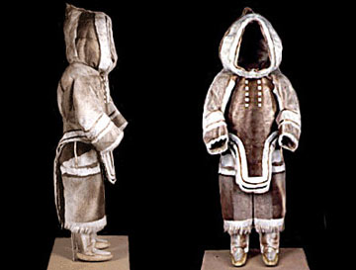
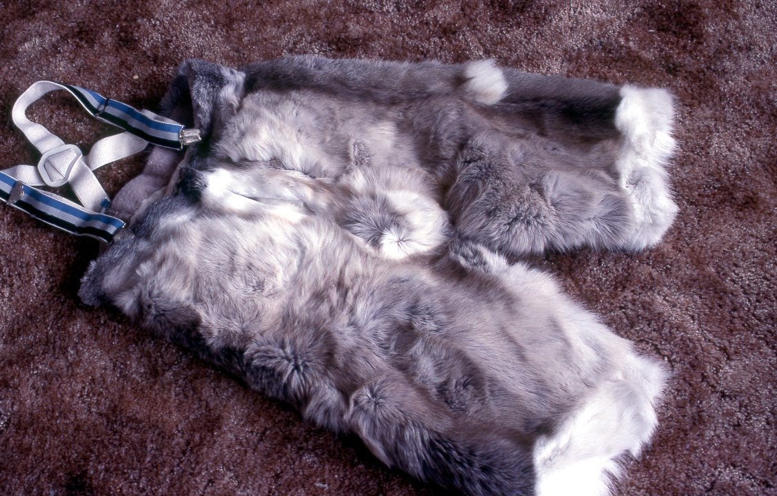
Rebecca
Children's Clothing
Children wore single piece garments that kept the youngsters' backs and bellies covered. The pants of the garments were split in the crotch area so the child could take care of bathroom needs without baring his skin. The hoods of children's garments were often constructed from the back part of a caribou head, often with the ears left intact.
Usually the Inuit wore clothing with two layers of caribou skin: an inner layer with the fur facing the skin, and an outer layer with the fur facing out. The Inuit people also made clothing from other animal skins, including dog, squirrel, marmot, fox, wolf, polar bear, bird skin, feathers, and sealskin.

Slide 7
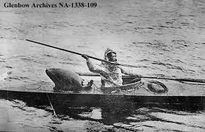
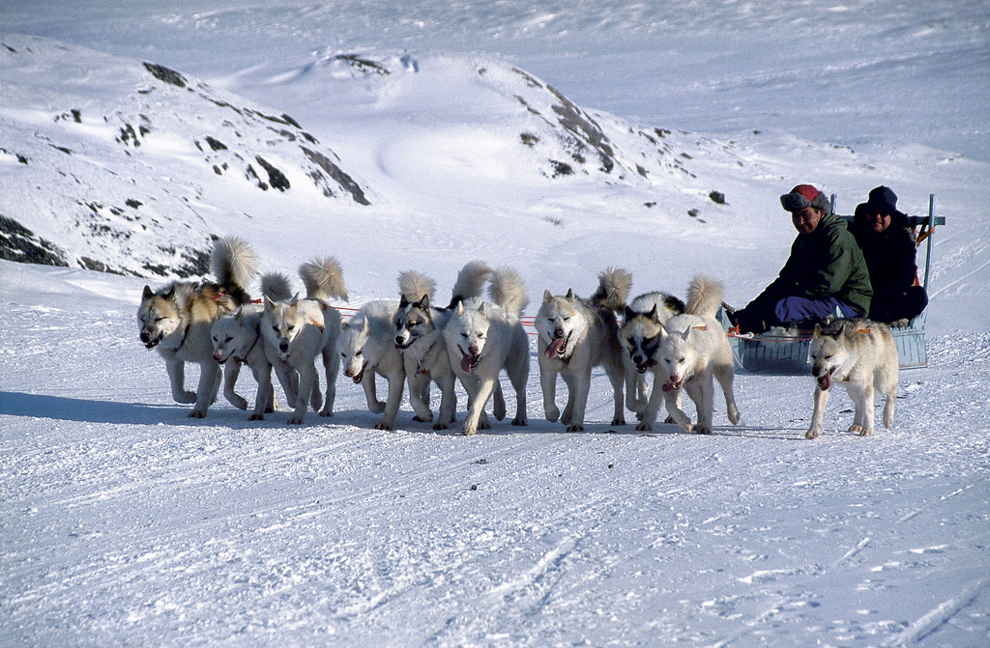
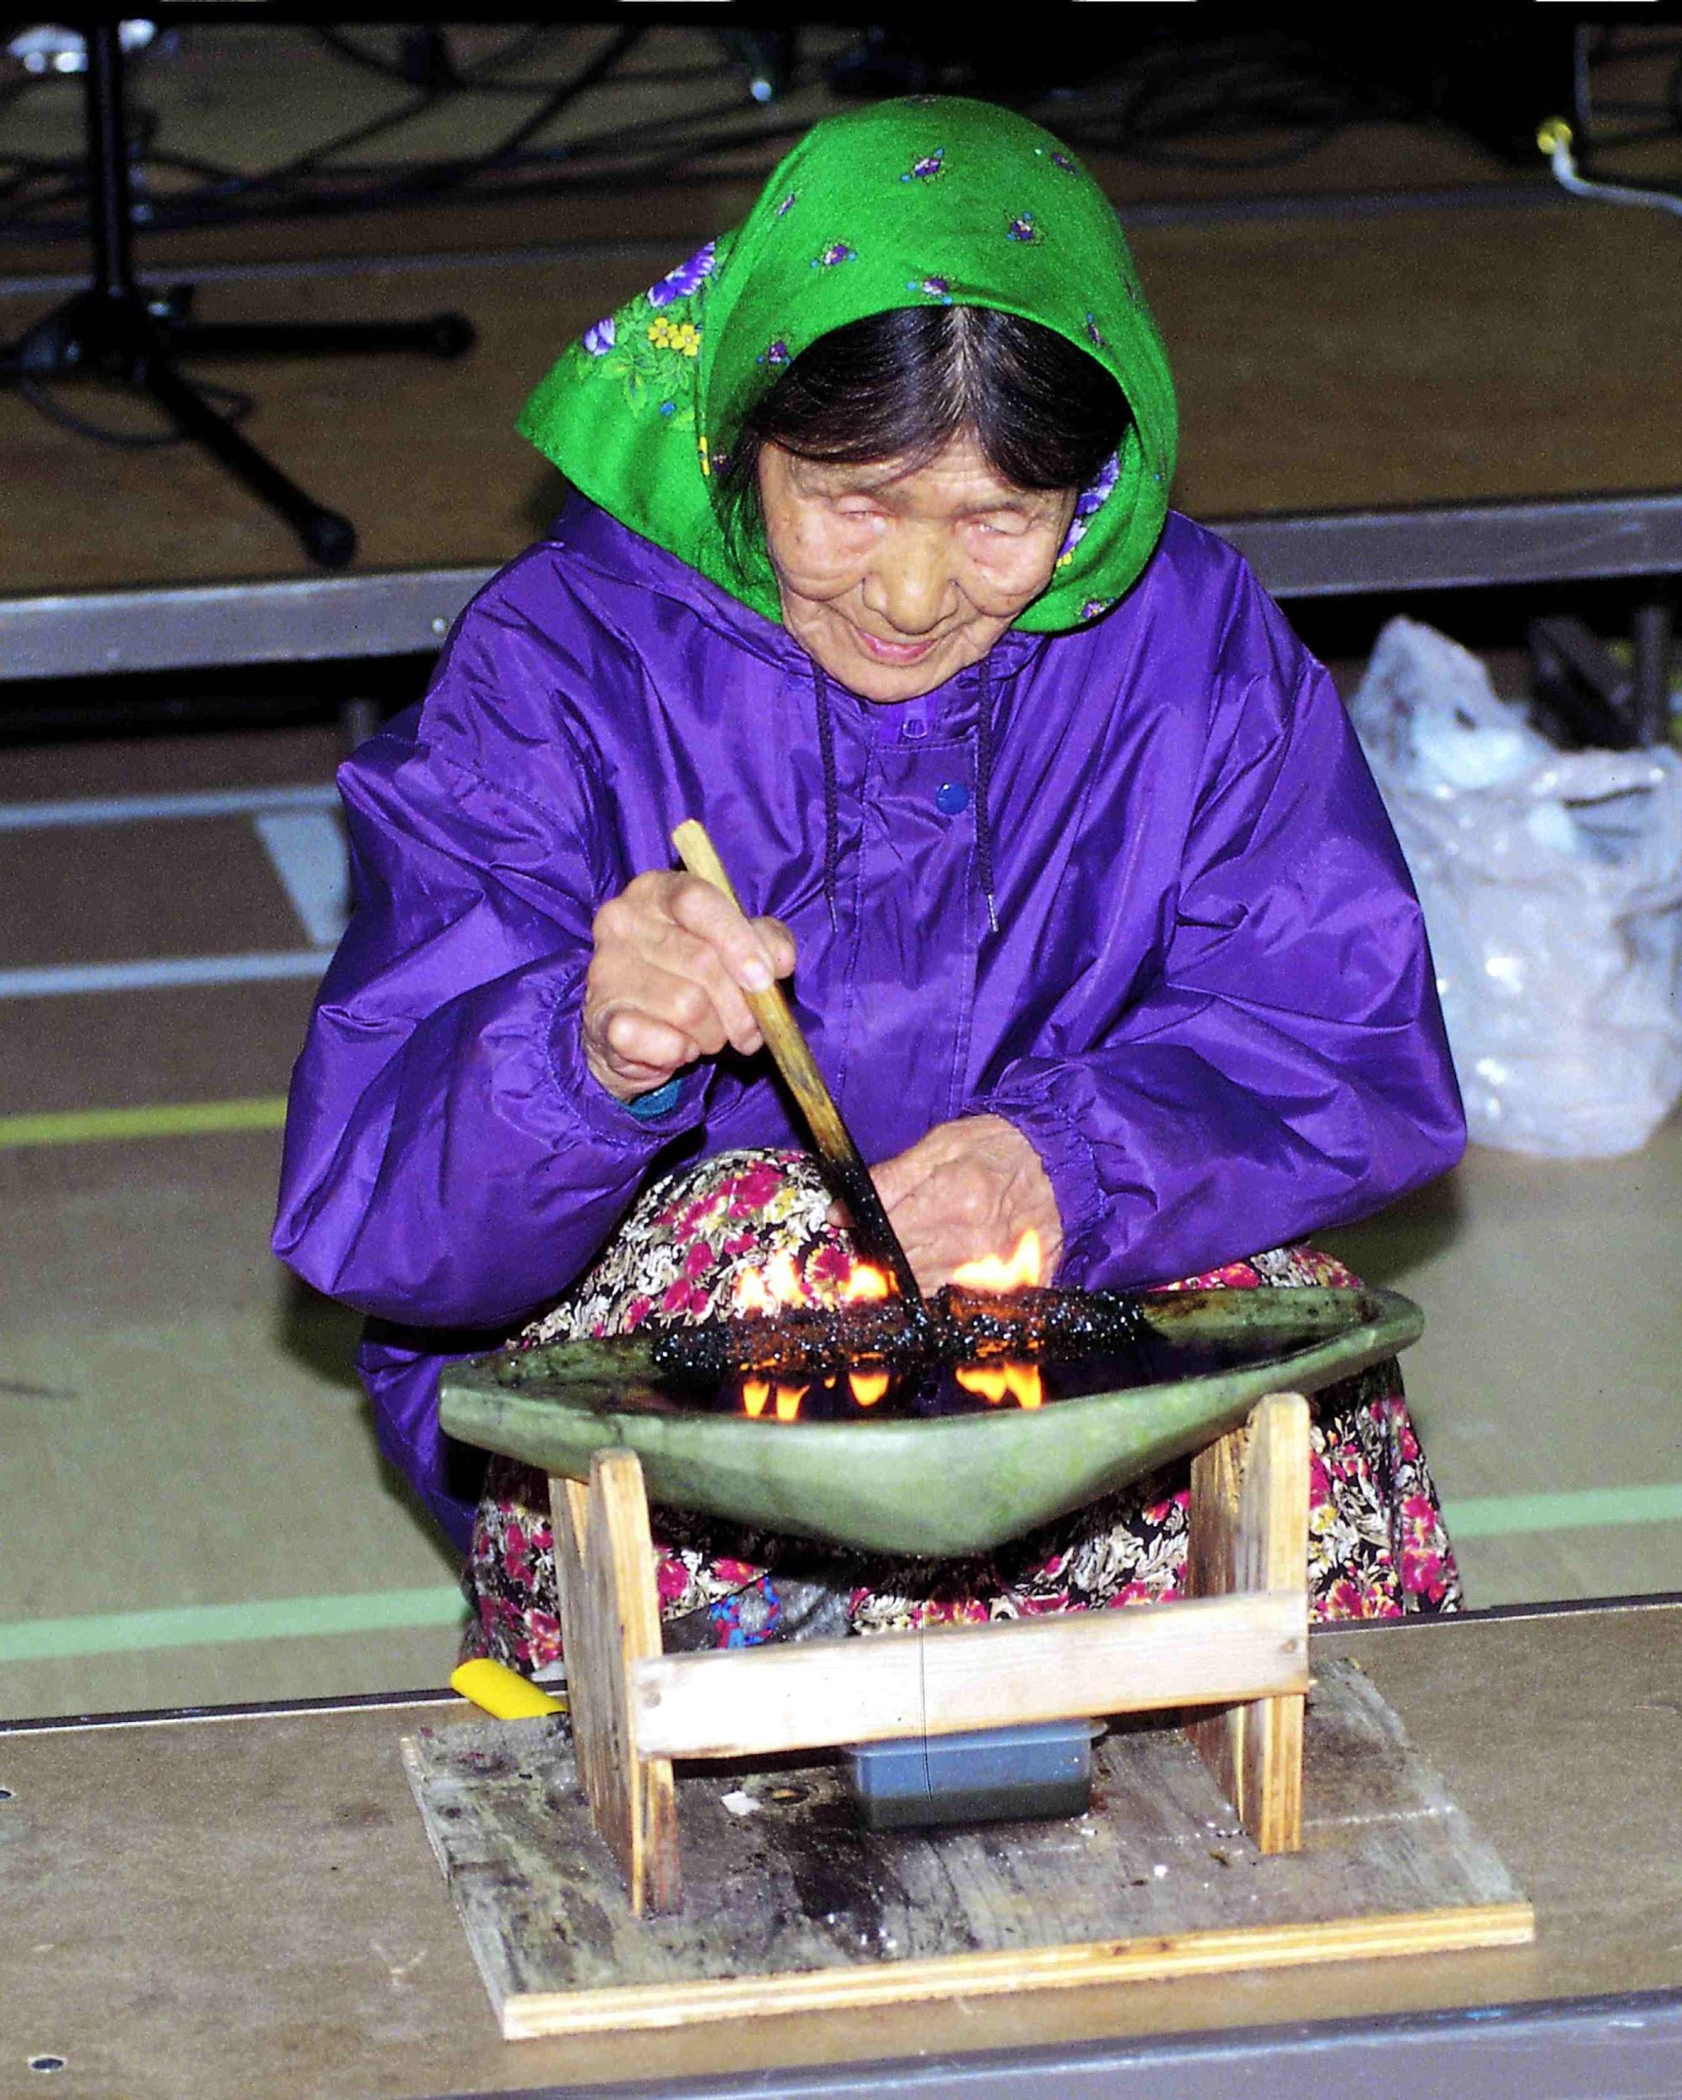
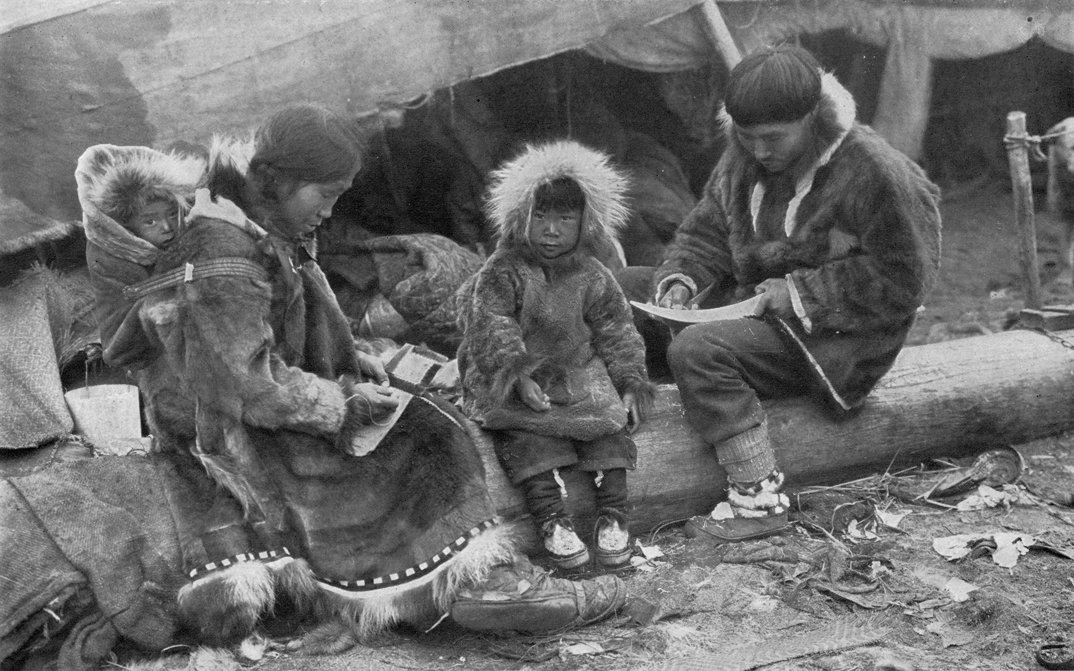
Community Resources by angel
Men
Hunting
Ice fishing
Women
Childcare
Sewing
Cooking
building homes
children
learned different skills from adults
Elders
telling stories
teaching the children
Transportation
dog sleds
kayaks

