Slide 1
The Inuit Tribe
Dallas, Gray , Devon , Sophia , and Eden
Notes:
Grey

Slide 2
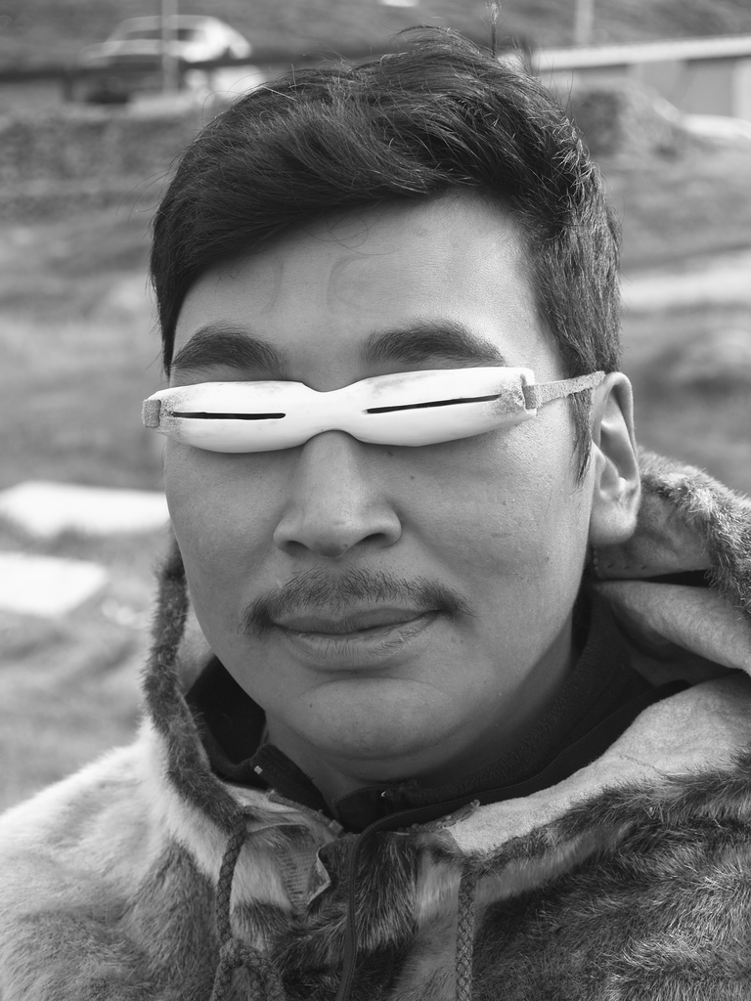
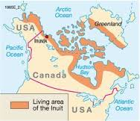
Geography by : Gray
Location: arctic region of what is now Alaska, Canada, and even parts of Greenland
Climate: avalanches and heavy snow . Snowy and rainy with hail
Land Features: icy land, few trees and plants
Nearby Tribes: Aluit and Tlingit
Fun Facts:
neighboring tribes called them “eskimo,” which means raw meat, because that is what they ate.
The Inuits wore masks so that when the sun reflected of the snow it would not get in their eyes.

Slide 3
Inuit Food BY DEVON
The Inuit were fishers and hunters.
They hunted whales, seals, caribou, walruses, birds, and even polar bears.
They did not eat many fruits or vegetables because there is not a lot of sunlight to grow crops in the arctic where they lived.

Slide 4
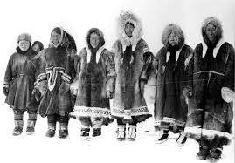
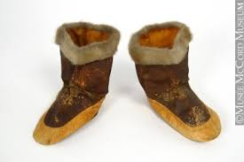
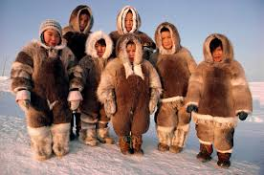
Inuit Clothing By:Eden
The Inuit tribe wore warm clothing because they lived the arctic.
They made their clothes out of animal hides and fur to keep warm in cold and wet winters.

Slide 5
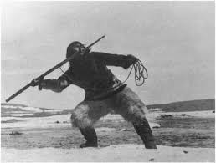
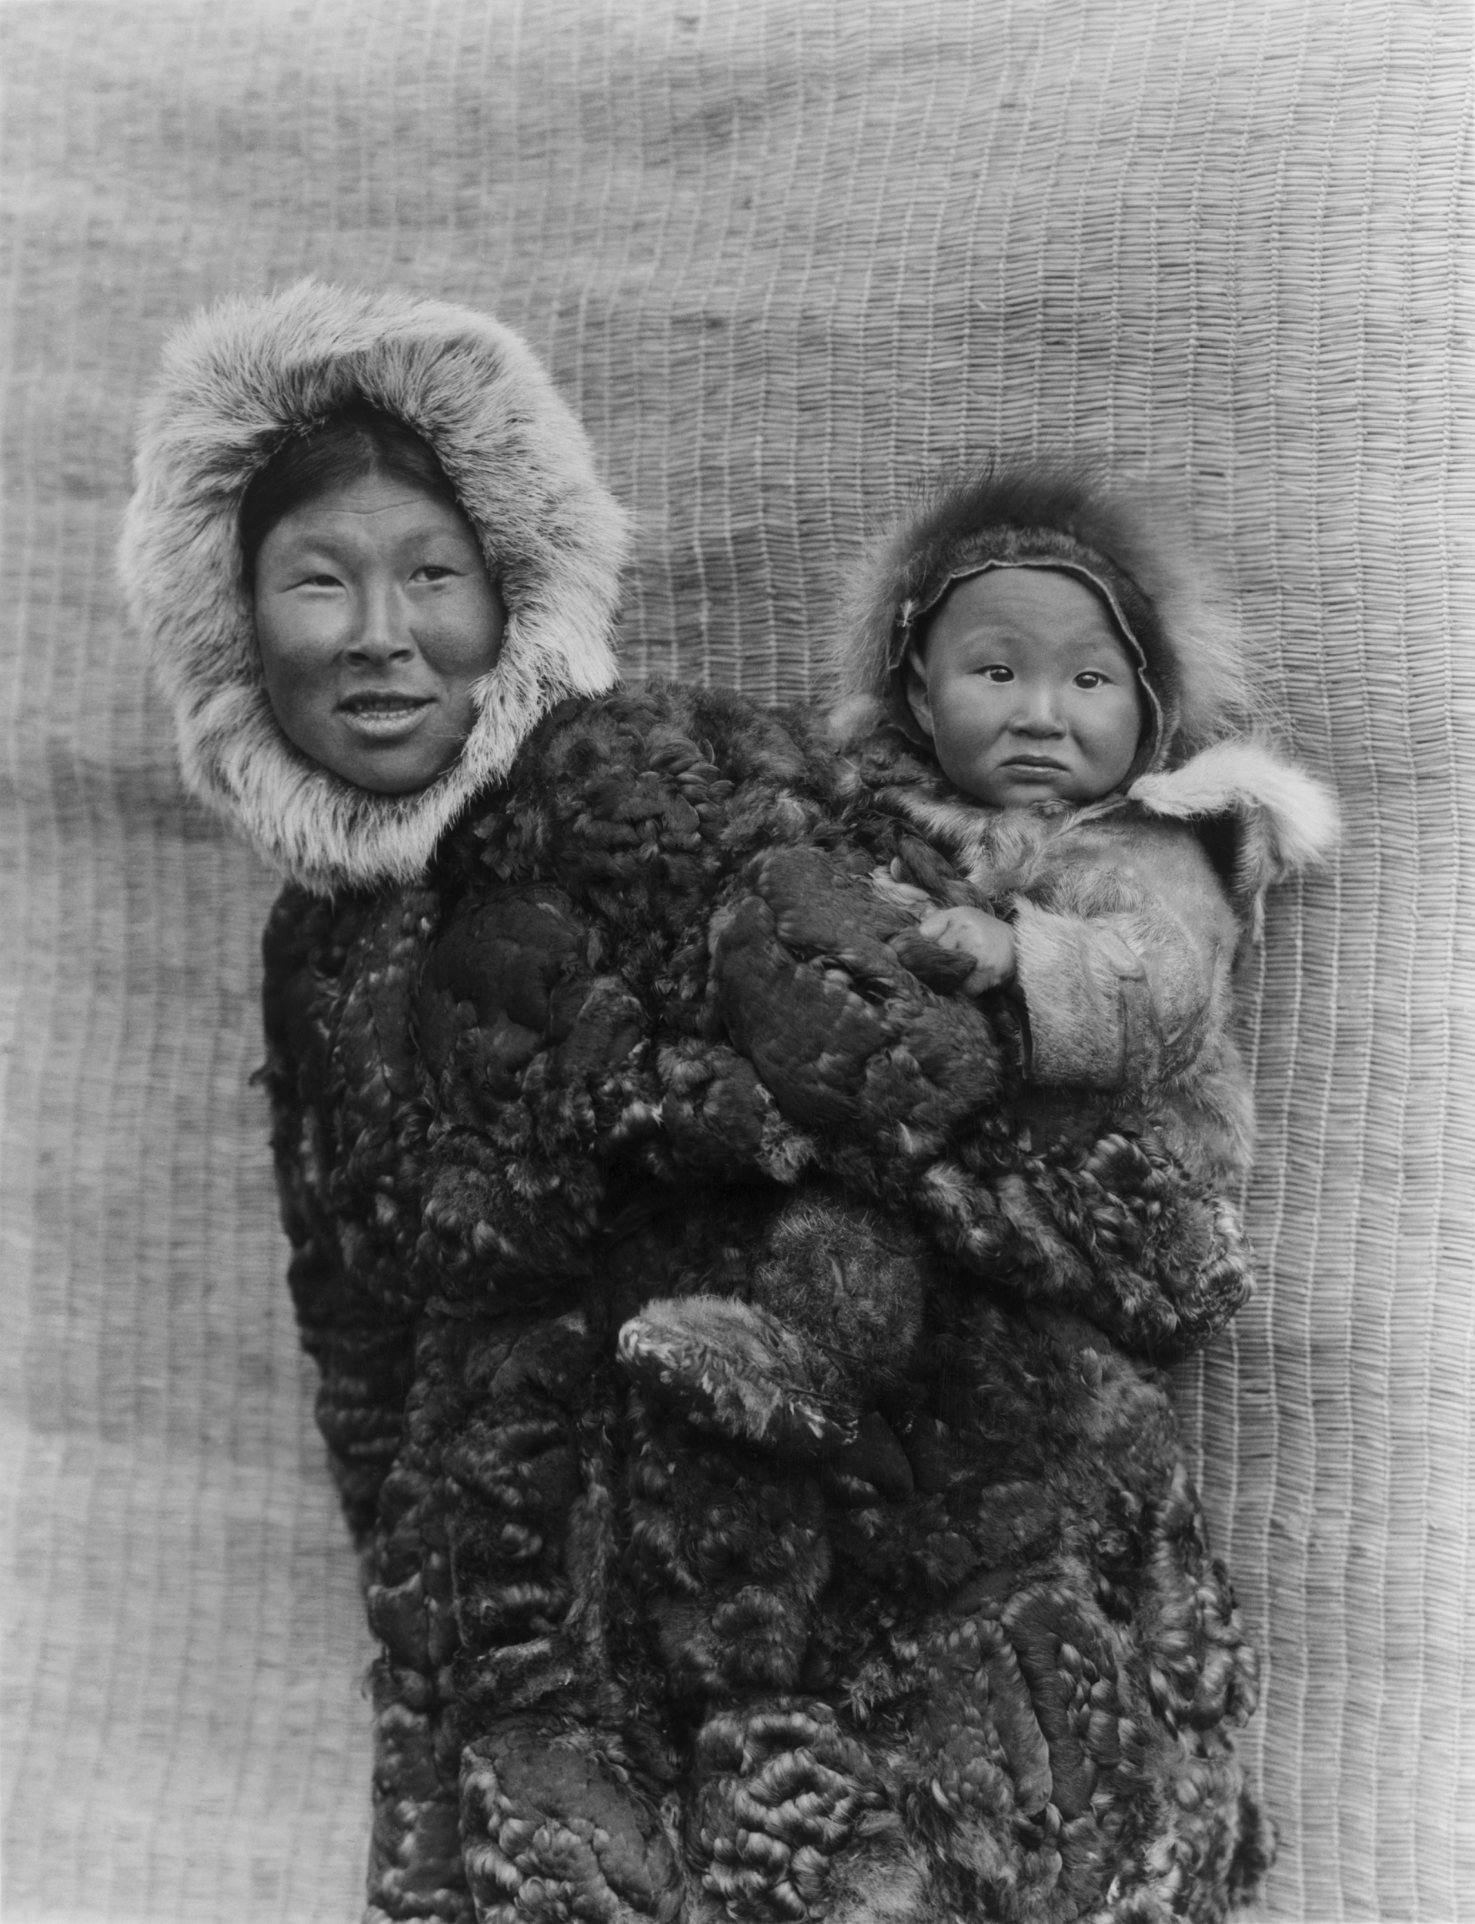
Community Resources: Sophia
Men:
Hunting
ice fishing
Had to know how to sew and cook on long hunting trips
Women:
Childcare
Cleaning
Sewing
preparing food
Some hunted when necessary

Slide 6
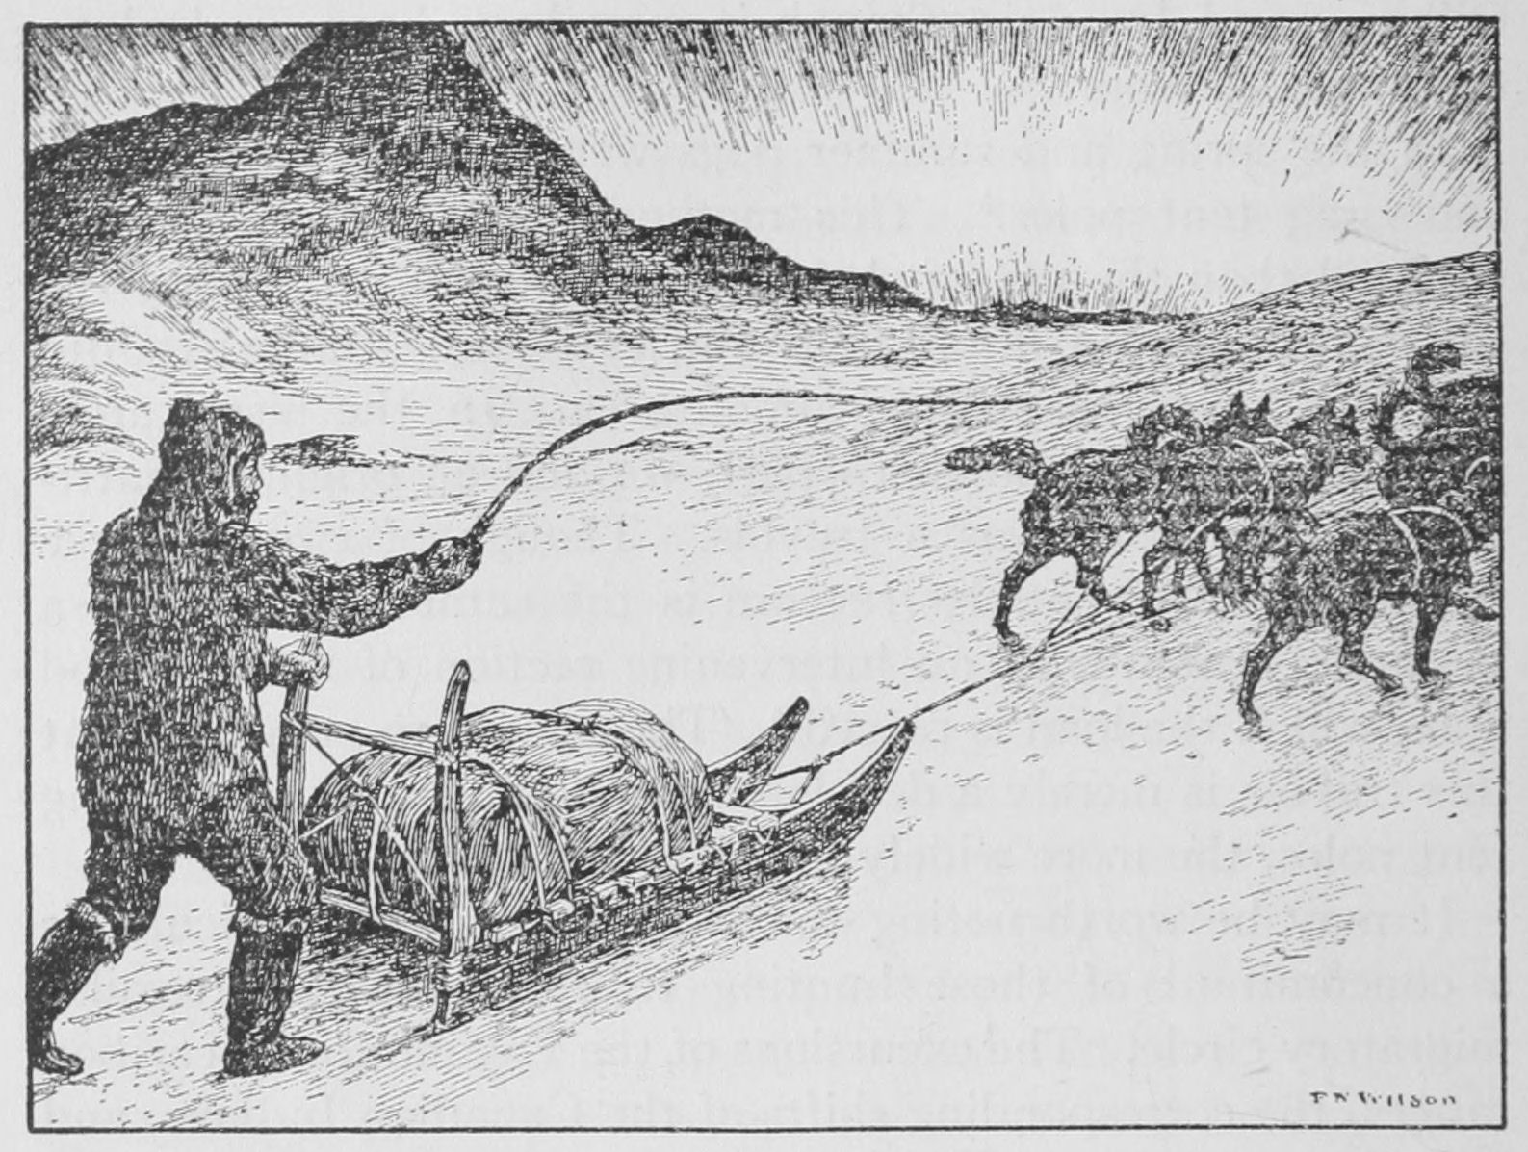
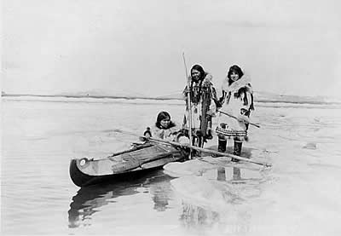
Community Resources: Sophia
Children: learned skills from adults
Elders: head of the household, storytellers
Transportation: dog sleds and kayaks

Slide 7
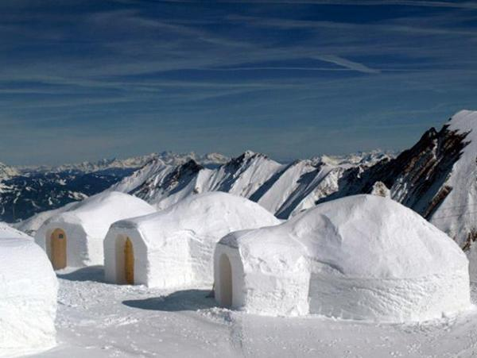
Homes by Dallas
2 types of homes
Winter:
igloos
made of snow and ice, tightly packed
kept heat inside (up to 100 degrees Fahrenheit!)
Summer:
tent
covered with animal skins (because igloos would melt!)
Notes:
Im awesoms

