Slide 1
Hopi Tribe
Avery, Mekatlyn, Yatziri, Judge, Preston

Slide 2
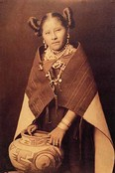
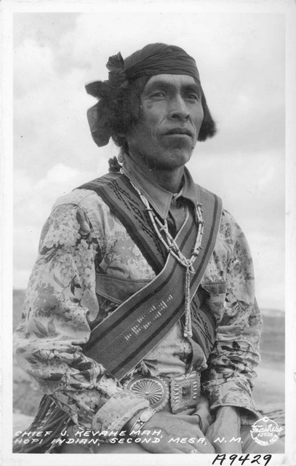
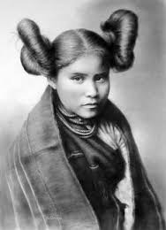
Hopi Tribe Fashion: Avery Michael
Men: only breechcloths or short kilts (man skirts)
Women: knee-length cotton dresses called mantas.
Both: deerskin moccasins on their feet.
Since there were few animals in the desert, the Hopi people grew cotton and used it to make clothes.
They wore this because it was hot in the desert so they needed clothes for winter and summer.

Slide 3
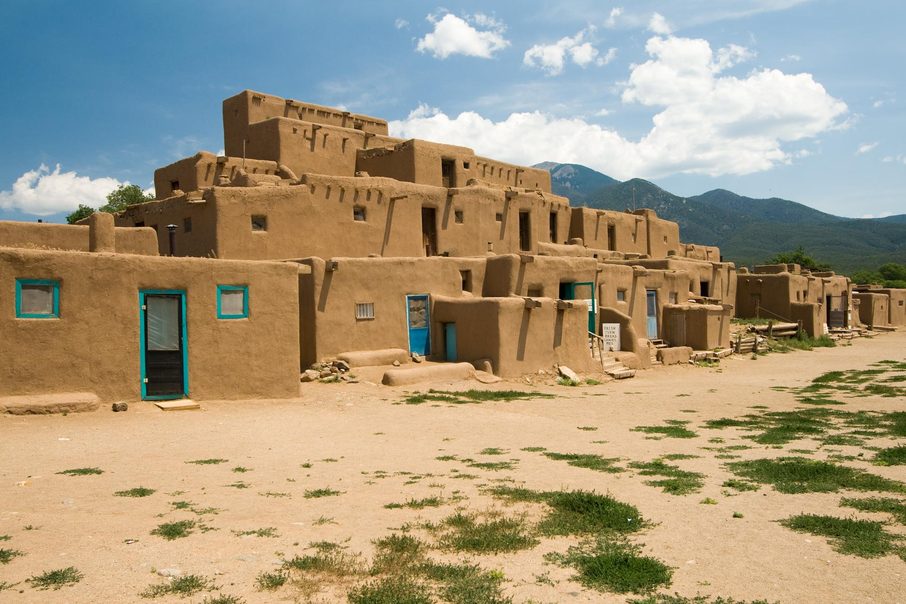
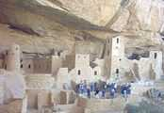
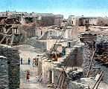
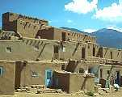
Homes by Judge
The country
The Hopi homes where made out of heated stone called adobe.
They could fit lots of Hopi people inside the homes.
They used ladders to get to the top floor.
The Hopi home was where they would store all the food and eat it.
The Hopi home was also a home to clans of all sorts from all over the continent

Slide 4
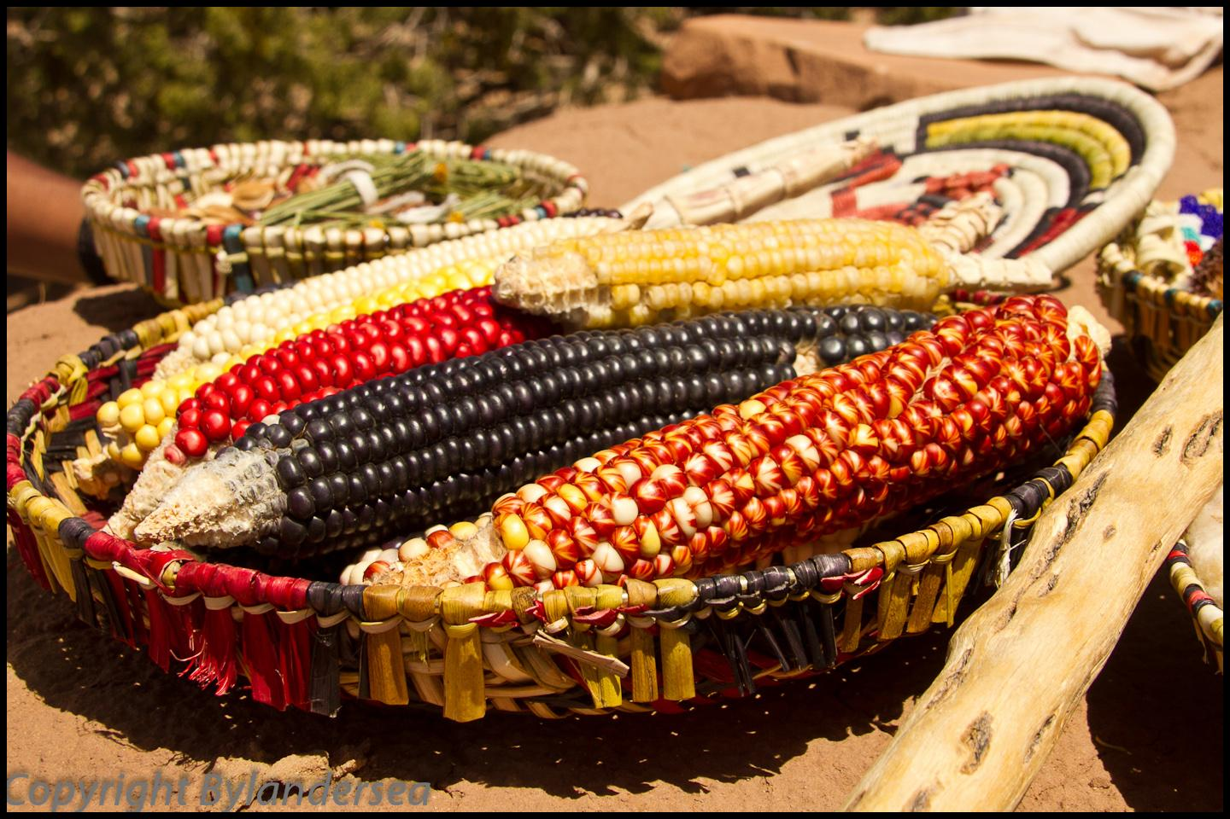
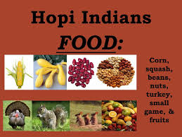
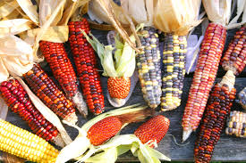
Native American Foods
:
By: Mekatlyn Cuyler
Crops:beans,sqaush,corn,nuts,greens,herbs,
Fruits:berries,currants,
Meat:deer,turkeys,and antalops
Also they used deer skin and turkey feathers for clothing.

Slide 5
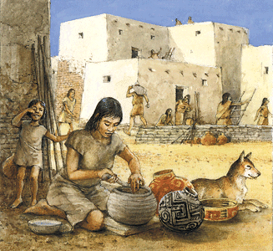
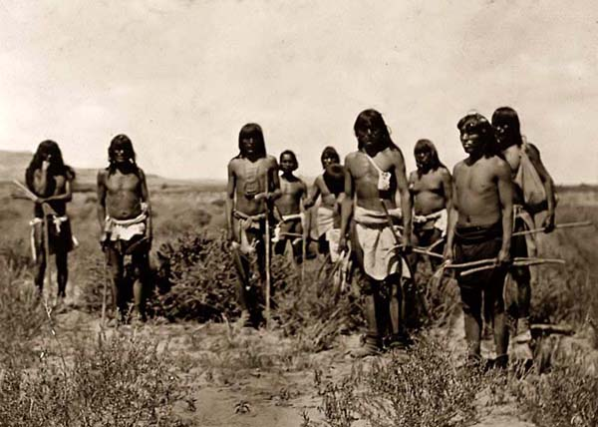
Community Resources: by Preston LePage
men: hunted deer, antelope, and small game
women: searched for nuts, berries, and herbs
Fun Fact: When the children are born, the parents wait 20 days and then they hold the child facing the sun, and then give it a name.

Slide 6
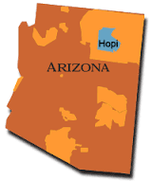
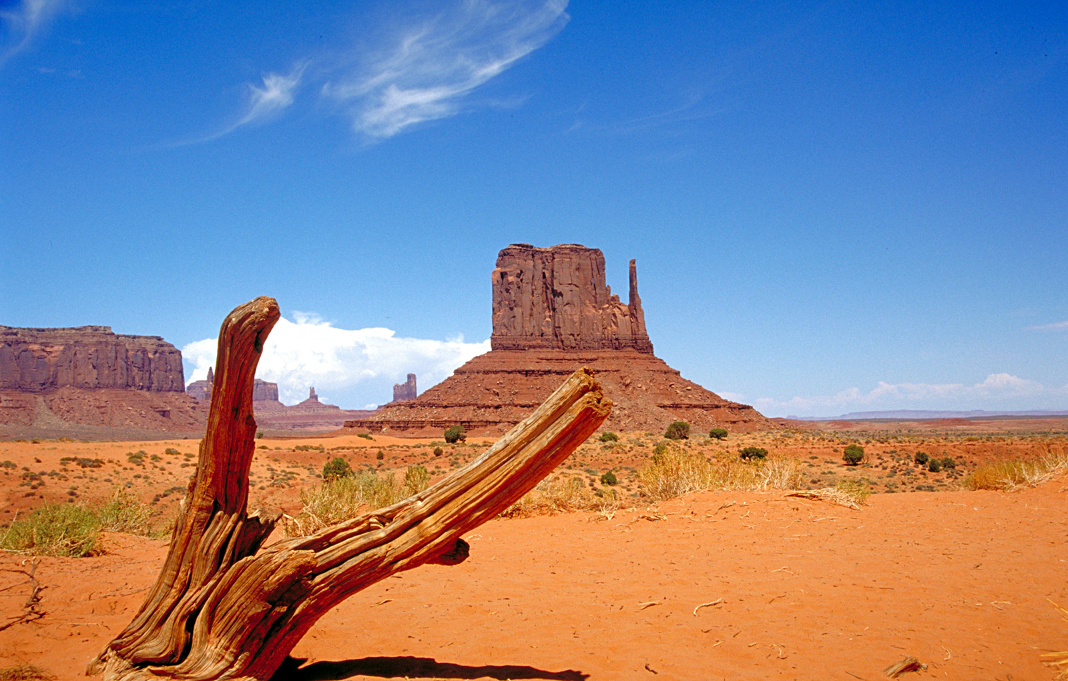
Geography by Yatziri
Location: (now) northeastern arizona.
geographical features:
Monument Valley
Colorado River (to the west)
Rocky Mountains (to the north)
Climate:
Very dry with little rainfall
43-67 degrees Fahrenheit in winter
81-106 degrees fahrenheit in the summer

Slide 7
Thank You For Watching

